Slide 1
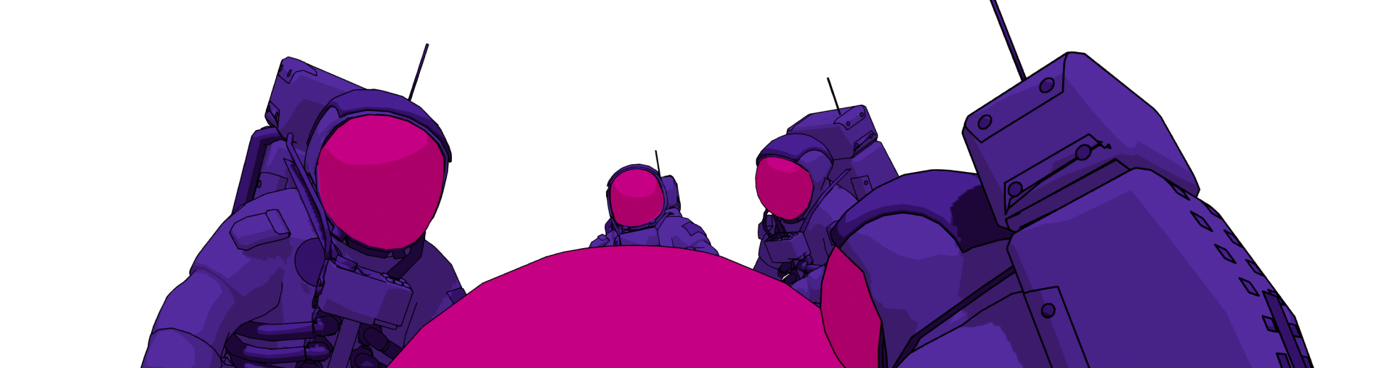
An Introduction to Polkadot
by Shawn Tabrizi

Slide 2
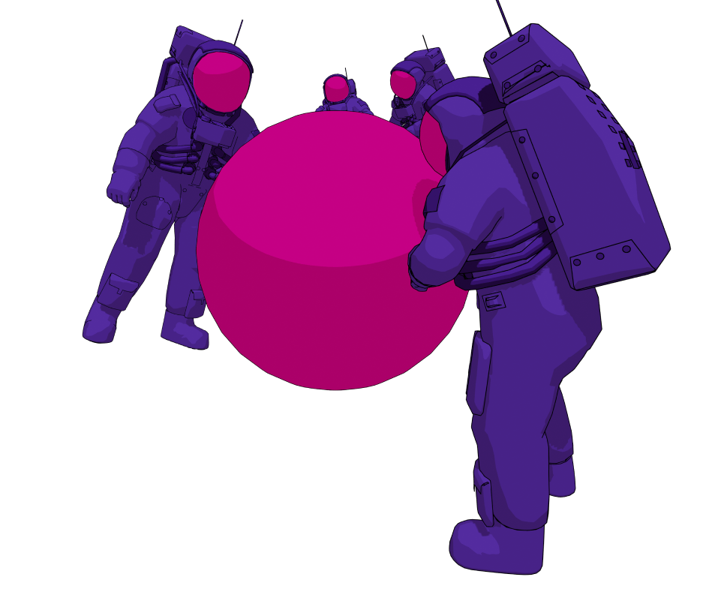
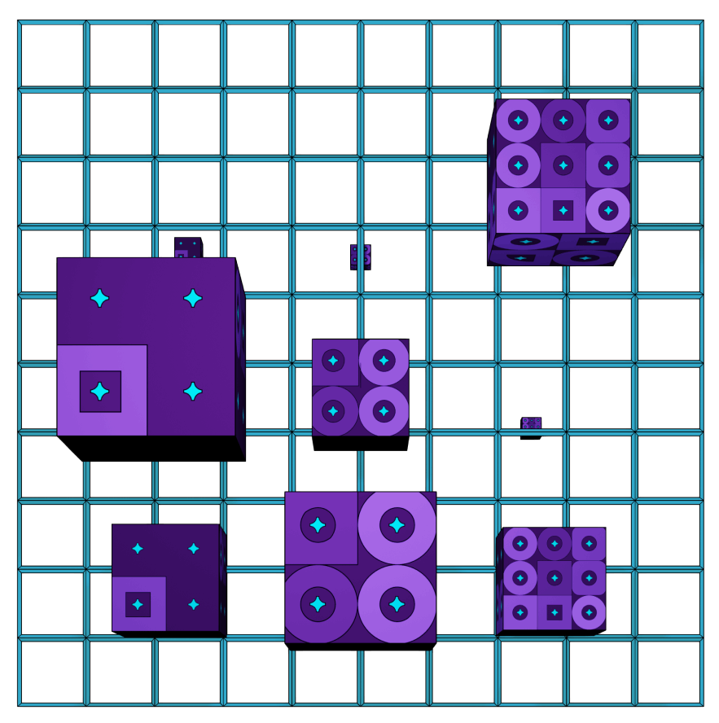
What we are going to cover today…
The Technology
The Ecosystem

Slide 3
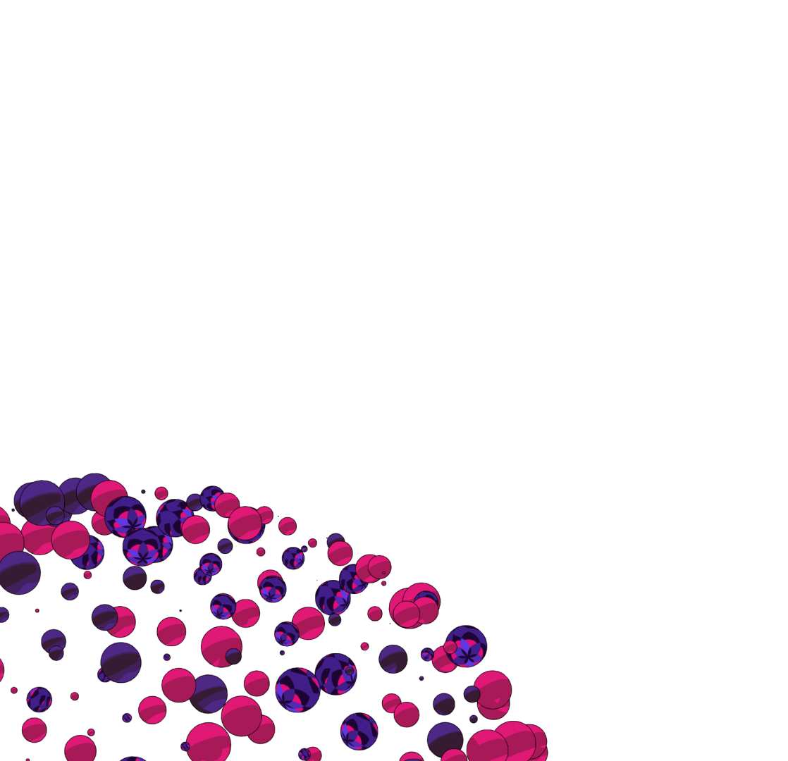
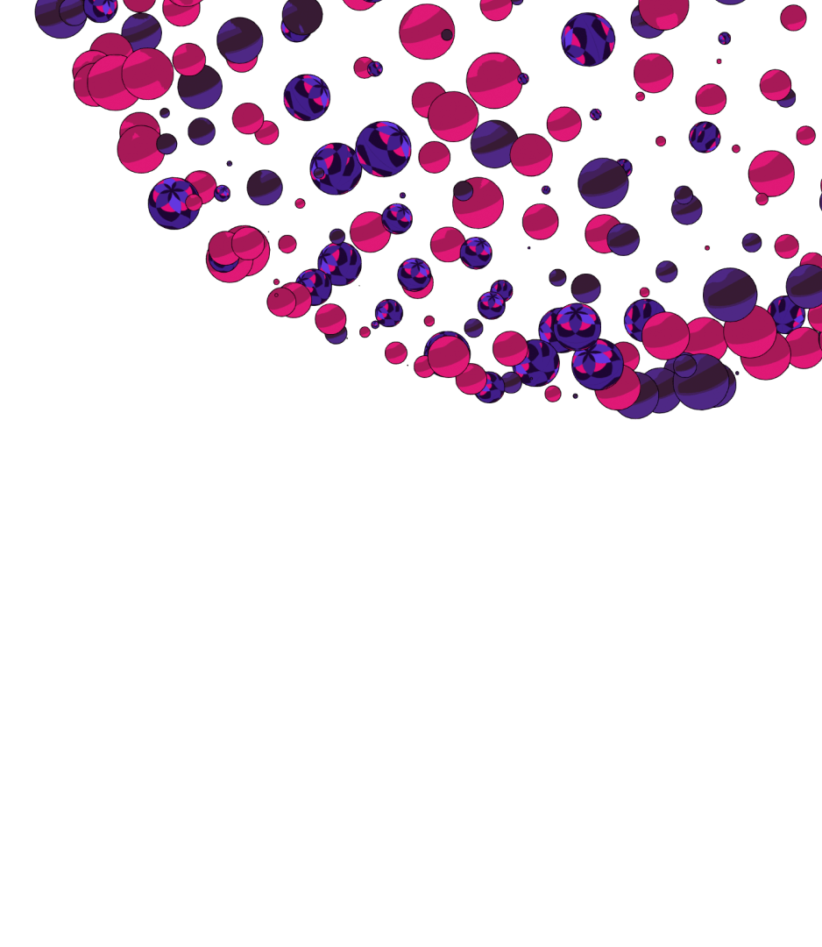
The Philosophies of Polkadot

Slide 4

LESS TRUST MORE TRUTH
Notes:
This is the slogan of the Web3 Summit, and seeing that Polkadot is our biggest bet on a Web3 future, it is apt that we use this phrase as a staple of the philosophy which backs Polkadot. The whole reason we have developed blockchain technologies was to address the trust problems that we face with those who wield power in our world.
I want to note the phrase is NOT “No Trust, Only Truth”. This, from what I can tell so far, is mostly impossible. We should not use points of trust to invalidate working solutions. For example, it is not an expectation everyone who uses Polkadot will read each individual line of open source code before they run it. Our goal should be to minimize trust, where possible, and make it obvious to everyone who uses our tools what kinds of trust assumptions they run on

Slide 5
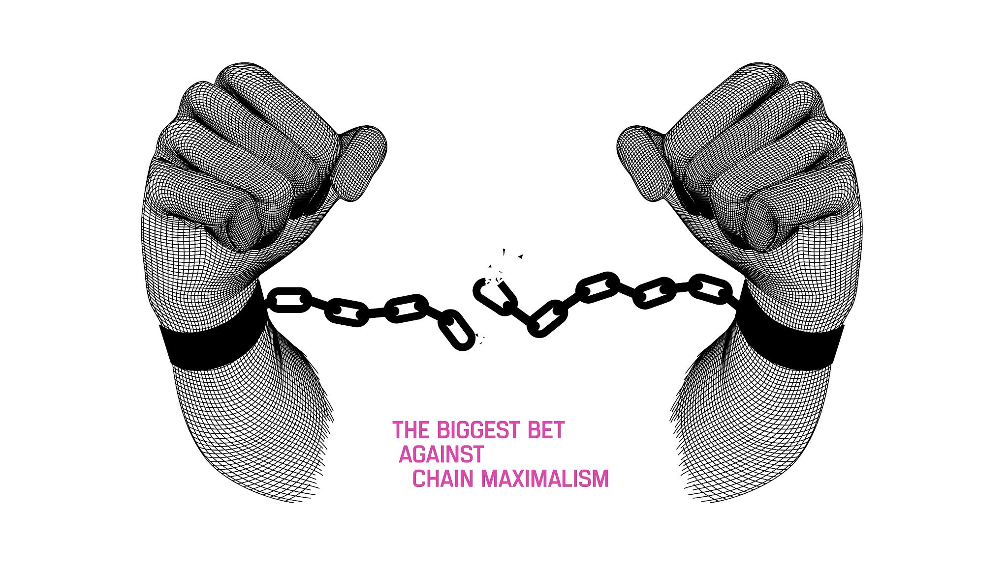
Notes:
Polkadot fundamentally believes in a multi-chain future. One where chains cooperate and provide greater value to one another, rather than where they strictly compete and try to kill one another. This is rare to find today, since cryptocurrencies are prone to becoming “investment vehicles”, where the creation of a new blockchain can be seen as a threat to the existing “investments”. With the blockchain maximalism mentality, people are choosing to value their “investments” over innovation and progression, and this isn’t best for our goals to provide the best technologies to the world.

Slide 6
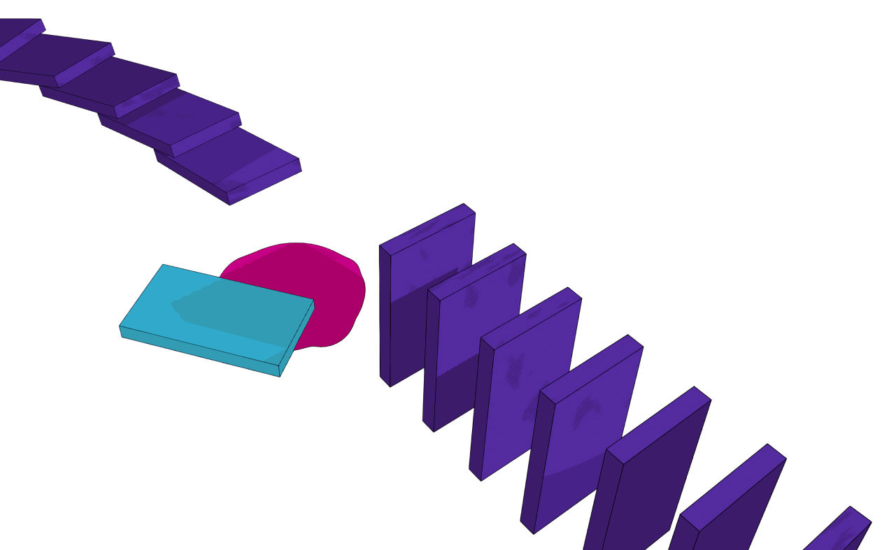
“The best blockchain today will not be the best blockchain tomorrow.”
Notes:
This philosophy is a realization that building a blockchain is trying to build a piece of software which will last forever. The we will not be successful engineering Polkadot simply for the problems we find today. By the time we have built X, the world will need Y, and so on. This is why we have invested so much time building platforms and SDKs, not just products. We need to make sure these technologies are able to adapt and evolve in order to stay relevant for users

Slide 7
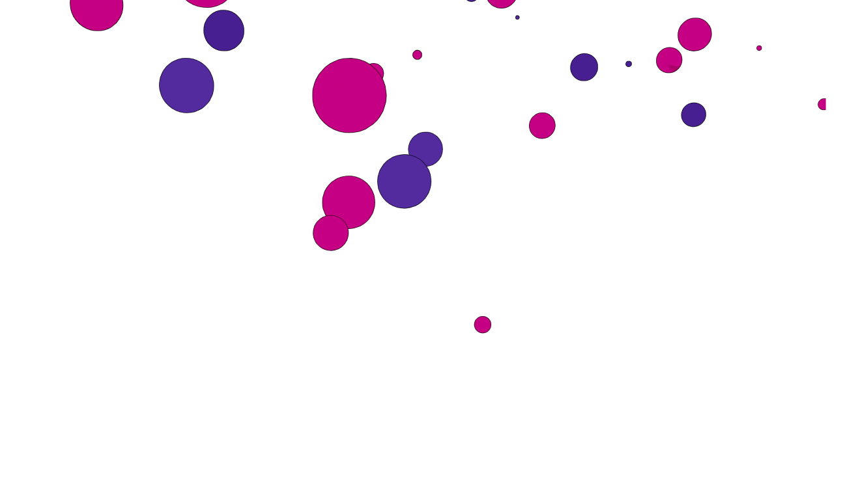
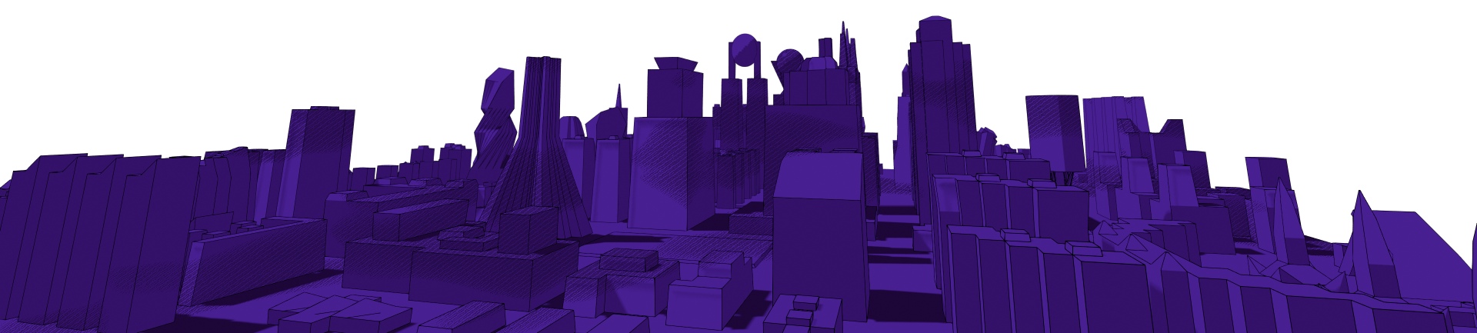
The Goals of Polkadot

Slide 8
The Blockchain Scalability Trilemma
Decentralization
Security
How much does it cost to attack the network?
Scalability
How much work can the network do?
Decentralization
How decentralized is the network?
Security
Scalability
Notes:
https://www.sec.gov/Archives/edgar/data/1018724/000119312516530910/d168744dex991.htm

Slide 9
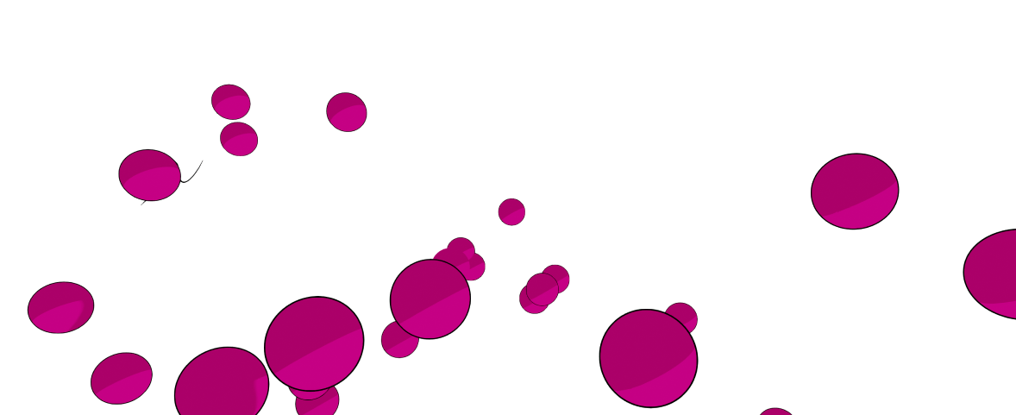
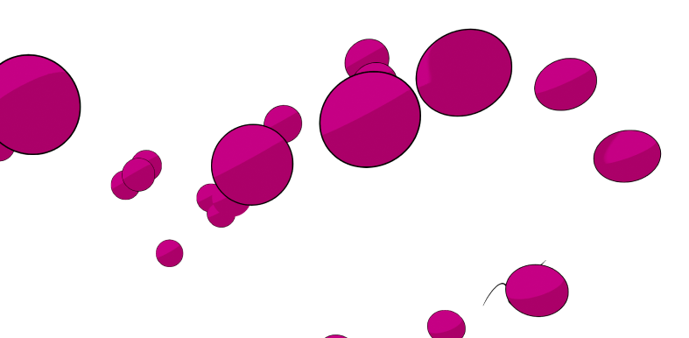
In one sentence…
Polkadot’s mission is to provide secure, scalable, and unstoppable infrastructure for Web3 applications and services.
Notes:
Note the difference between “decentralization” as a mission vs “unstoppability”.

Slide 10
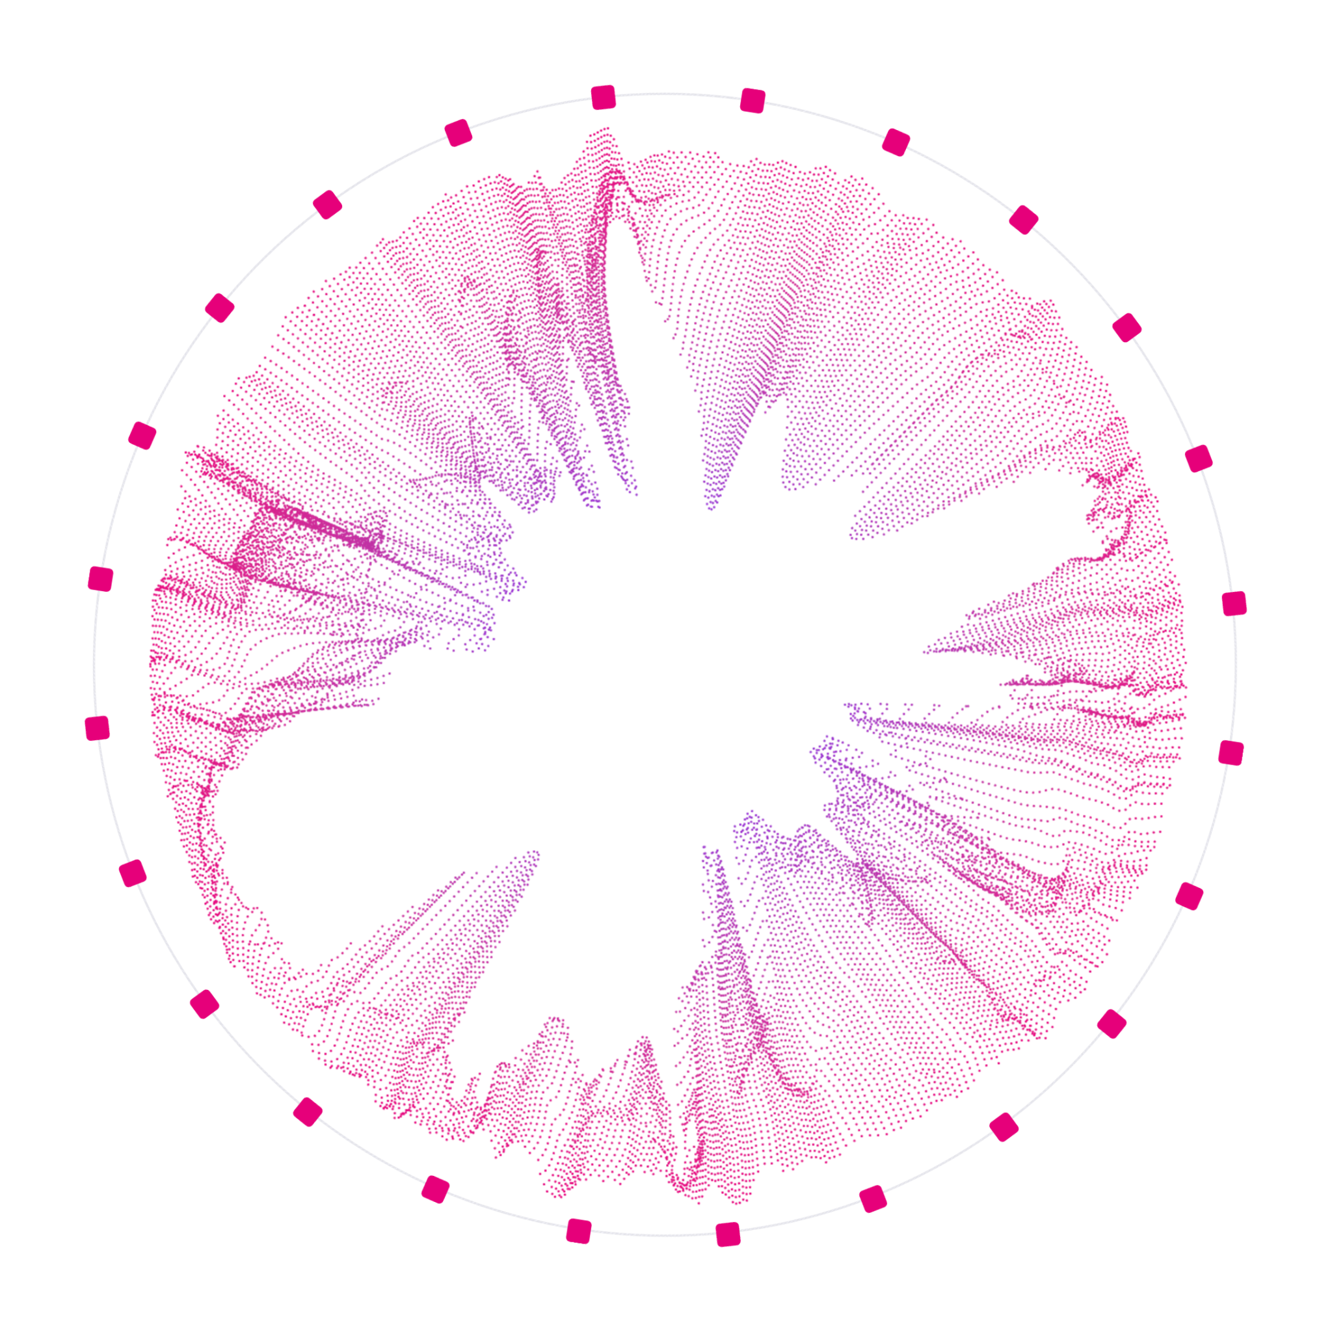
What is Polkadot?
Polkadot is an ecosystem of connected and secured blockchains, called “Parachains”.
It is a vision toward a scalable multi-chain future.

Slide 11
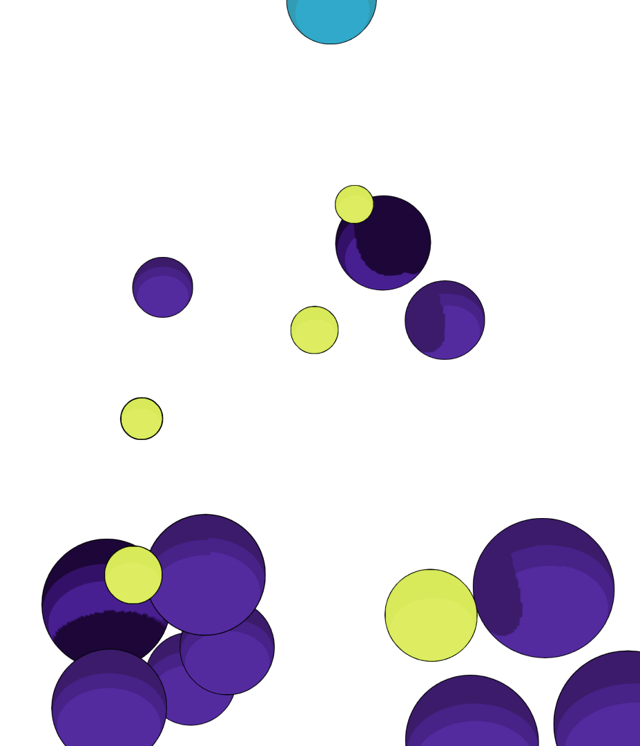
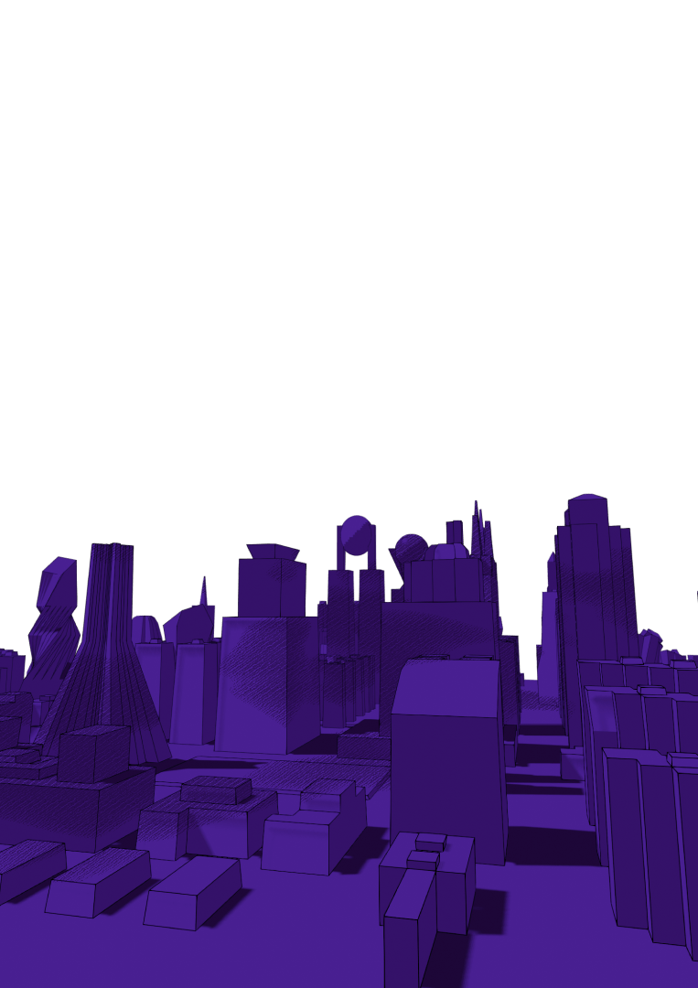
Polkadot tries to accomplish that mission by solving three problems:
Computational Scalability
Shared Security
Interoperability

Slide 12
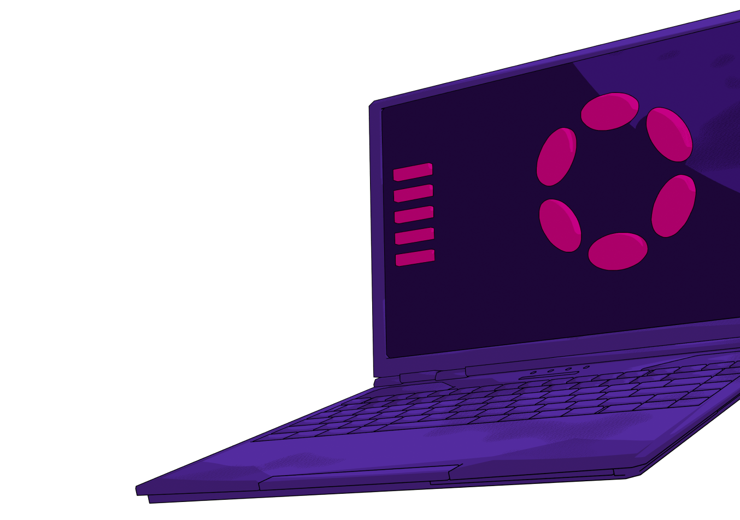
The Technology

Slide 13

Wasm
WebAssembly is the backbone of Polkadot. It is a fast, safe, and open meta-protocol which powers all of the state transitions of our ecosystem.
It standardizes how chains execute, and allows for any programming language that can be compiled into Wasm to be used to build in Polkadot.
Notes:
similar to:
Cosmos Zones
Avalanche Subnets
better than:
Homogenous shards (ETH2)
fixed shards (NEAR)

Slide 14
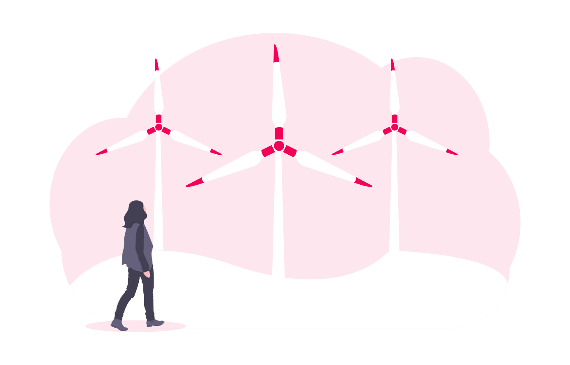
Sharding
Polkadot’s primary scaling solution comes from parallelization of execution allowed by creating separate data shards.
These parallel chains are called Parachains.
Notes:
better than
single chain scaling
optimistic parallelization
similar to
Ethereum sharding roadmap
roll-up solutions
data-availablity groups (NEAR)
Subnets (Avalanche)

Slide 15
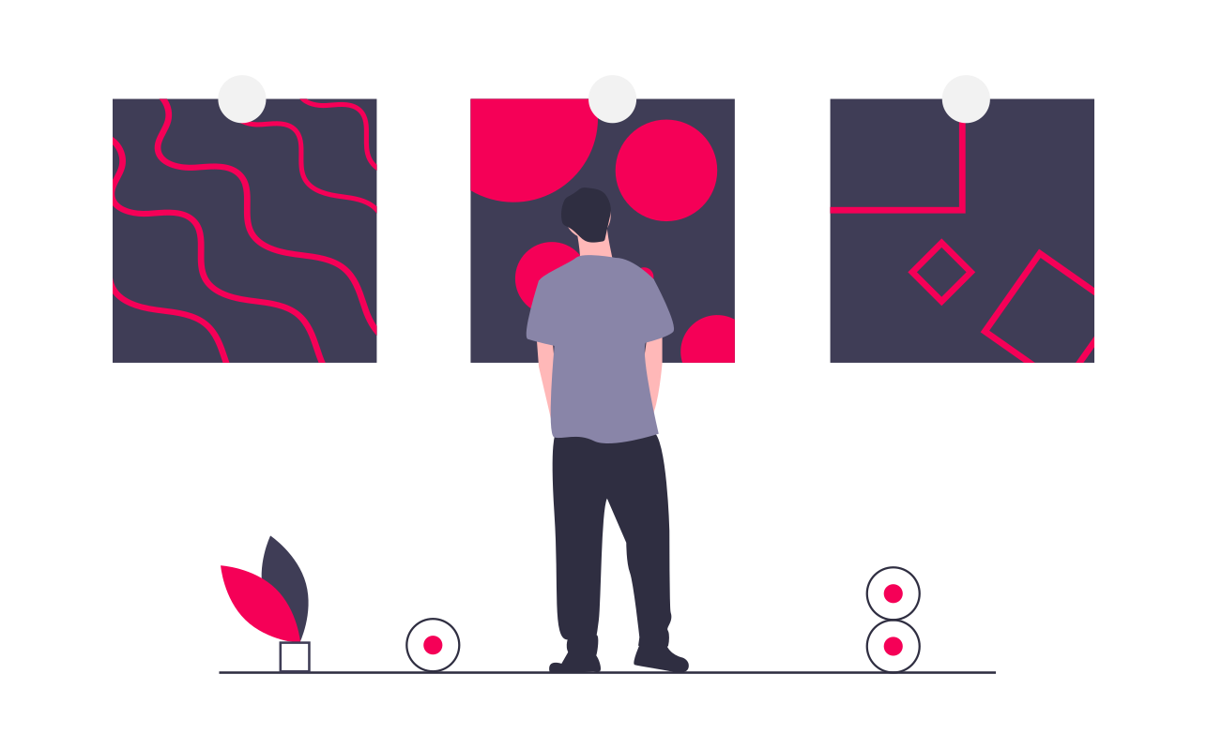
App-Chains
Another key scaling decision is the choice of heterogeneous shards, allowing for application specific chains.
Specialized solutions for problems are more performant than generalized solutions, as they can incorporate more details about the problem space.
Notes:
similar to:
Cosmos Zones
Avalanche Subnets
better than:
Homogenous shards (ETH2)
fixed shards (NEAR)

Slide 16
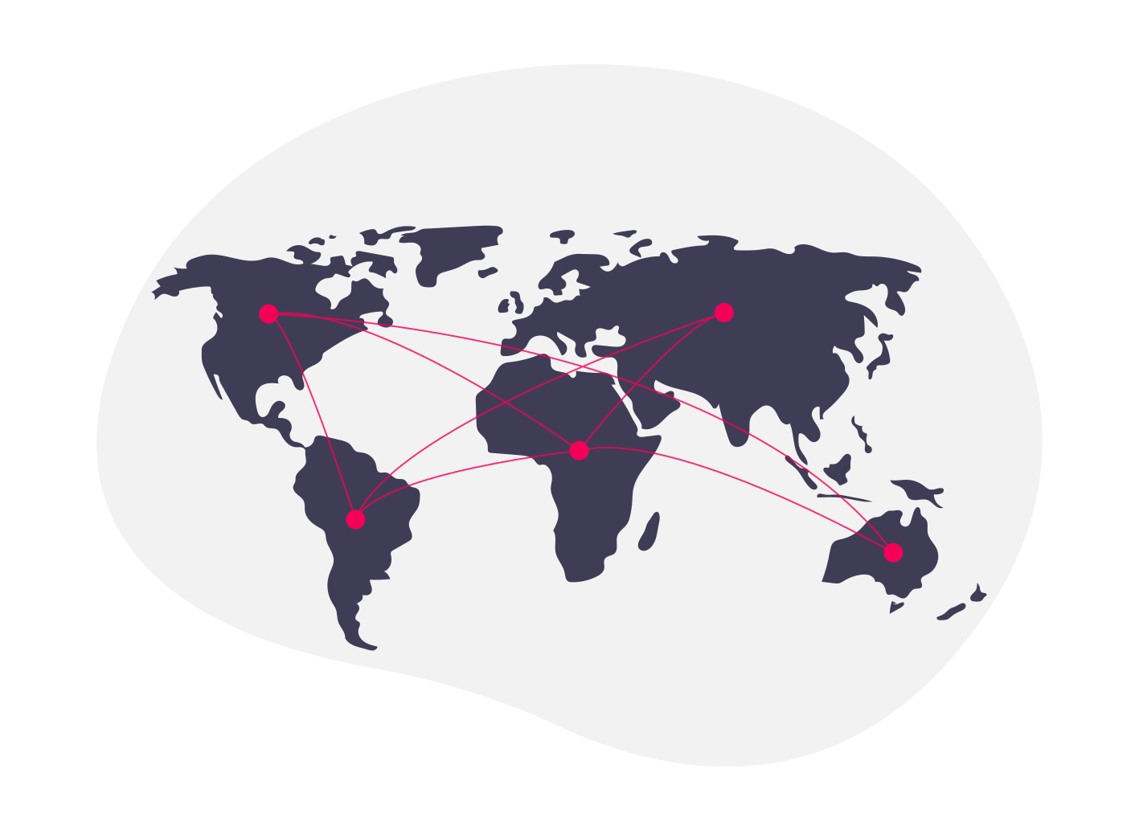
Interoperability
Individual application chains will inherently lack the ability to provide a full suite of solutions for end users.
Interoperability allows parachains to work together to complete, complex end-to-end scenarios.
Notes:
better than
single chain scaling
optimistic parallelization
similar to
Ethereum sharding roadmap
roll-up solutions
data-availablity groups (NEAR)
Subnets (Avalanche)

Slide 17
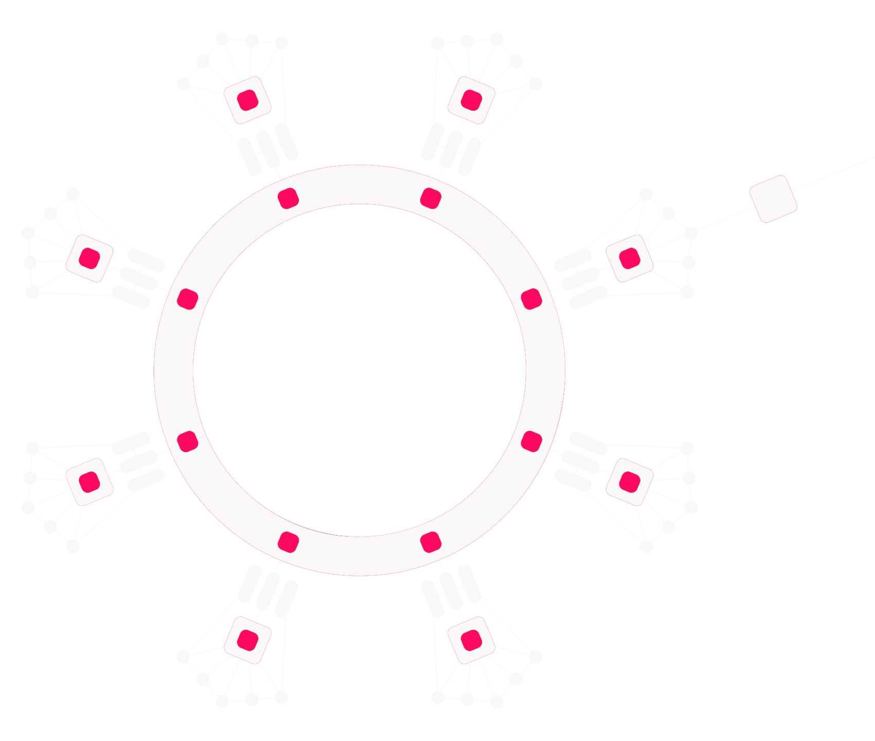
XCMP
Cross-Chain Message-Passing
XCM
Cross-Consensus Message Format
Withdraw Asset
Initiate Teleport
Buy Execution
Many open message channels across Parachains on Polkadot.
Deposit Asset
The XCM instructions to teleport an asset from one parachain to another.
...

Slide 18
Shared Security
An often overlooked problem is economic scaling of the entire blockchain ecosystem.
Polkadot is unique in that it provides all connected parachains with the same security guarantees as the Relay Chain itself.
Notes:
Security in proof-of-stake networks depends on economics, so there can only exist a limited amount of security in the world because economic value is, by definition, limited. As the number of blockchains increases due to scaling issues on single chains, their economic value — and therefore their security — gets spread out over multiple chains, leaving each one weaker than before.
Polkadot introduces a shared security model so that chains can interact with others while knowing full well that their interlocutors have the same security guarantees as their own chain. Bridge-based solutions — where each chain handles its own security — force the receiver to trust the sender. Polkadot’s security model provides the necessary guarantees to make cross-chain messages meaningful without trusting the security of the sender.

Slide 19
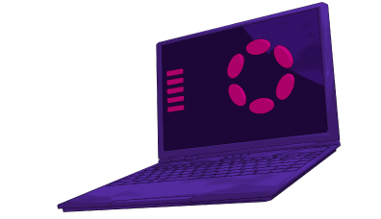
Wasm
Parachains Protocol
Relay Chain
WebAssembly is a key part of enabling trust-free shared security and interoperability. It allows the Relay Chain to trustlessly validate the blocks of connected parachains.
The Parachains Protocol is comprised of many subsystems such as the PVF (Parachain Validation Function), Approval Process, Inclusion Pipeline, AnV (Availability and Validity Protocol), etc… It is the most advanced multi-chain coordination software that exists today.
A coordination chain that manages its own block producers, parachain validators, consensus and finality across all parachains, and more. It is what many people think of when we say “Polkadot”, but is really just one small part of the overall ecosystem.

Slide 20
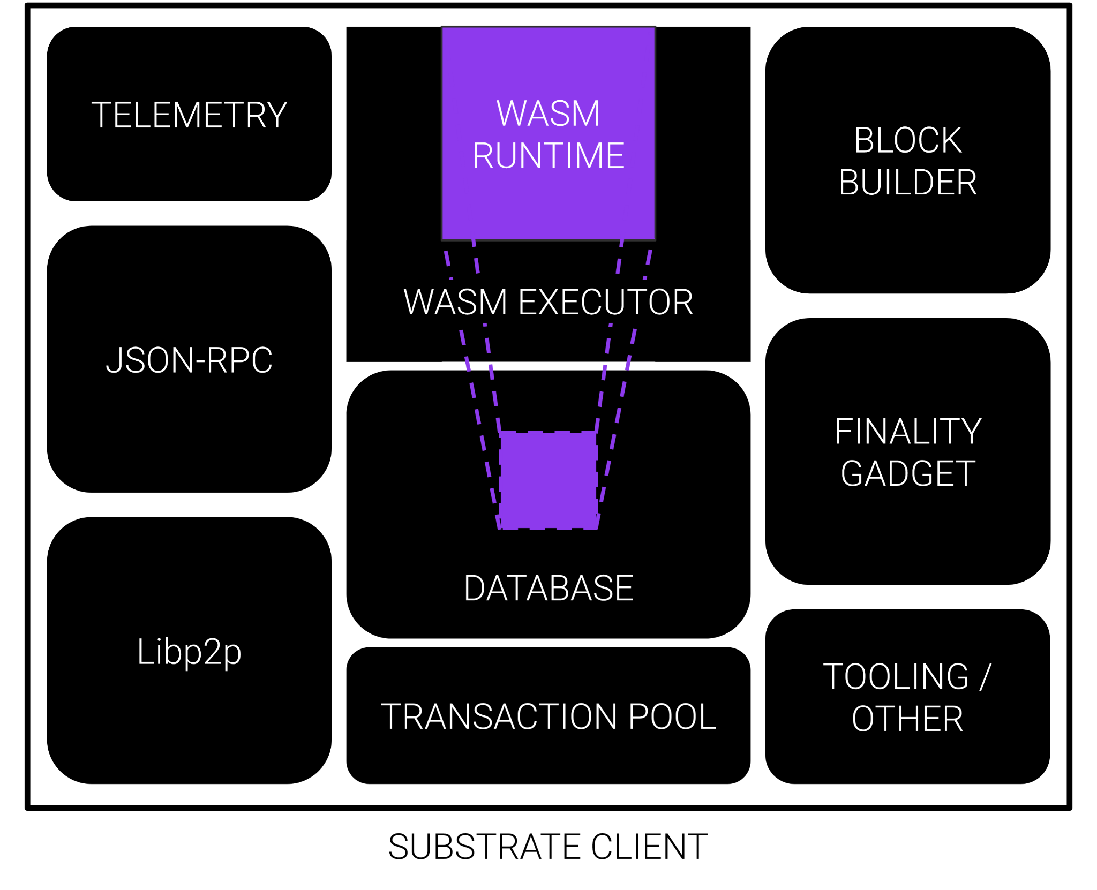
In the Polkadot ecosystem, each chain has their state transition function represented by a Wasm blob which is stored on the blockchain itself.
This has many implications, but the key point here is that it is very easy to share and safe to execute.

Slide 21
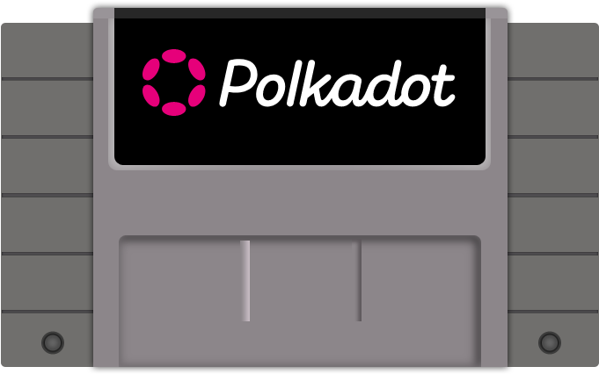
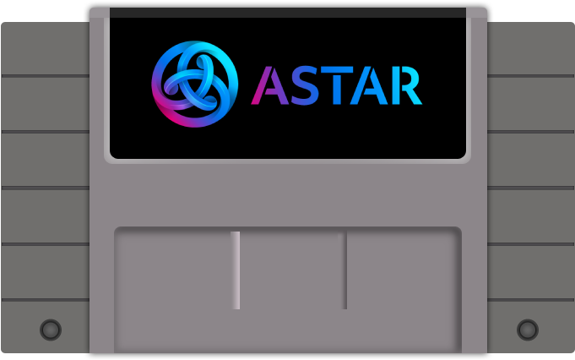
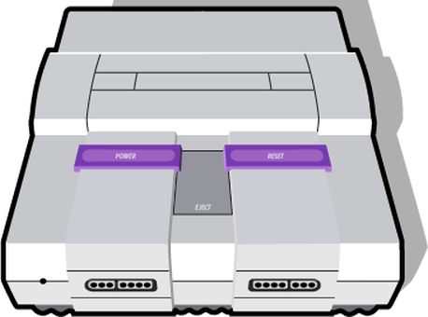
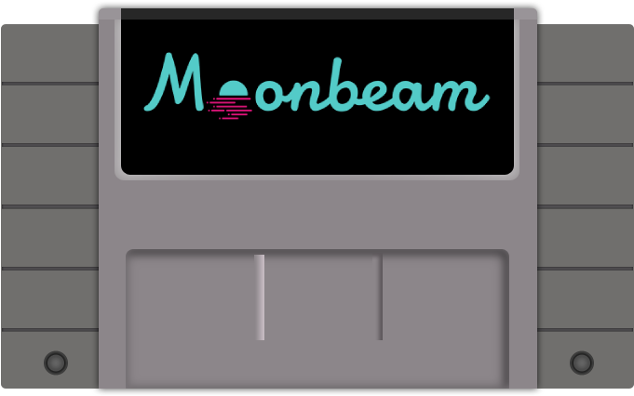
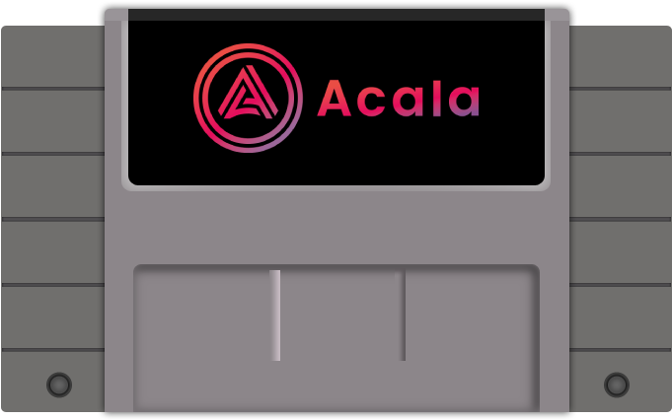
Basic Polkadot Client
Wasm Runtimes
Game Console Analogy

Slide 22
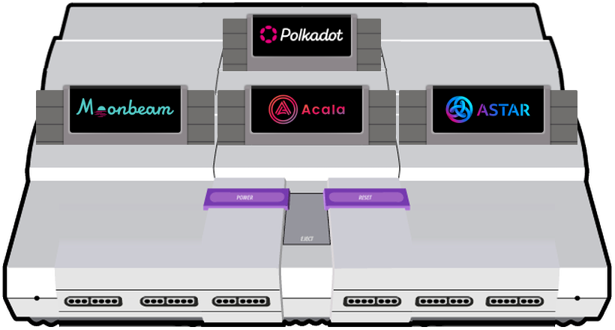
A Polkadot Validator Node

Slide 23
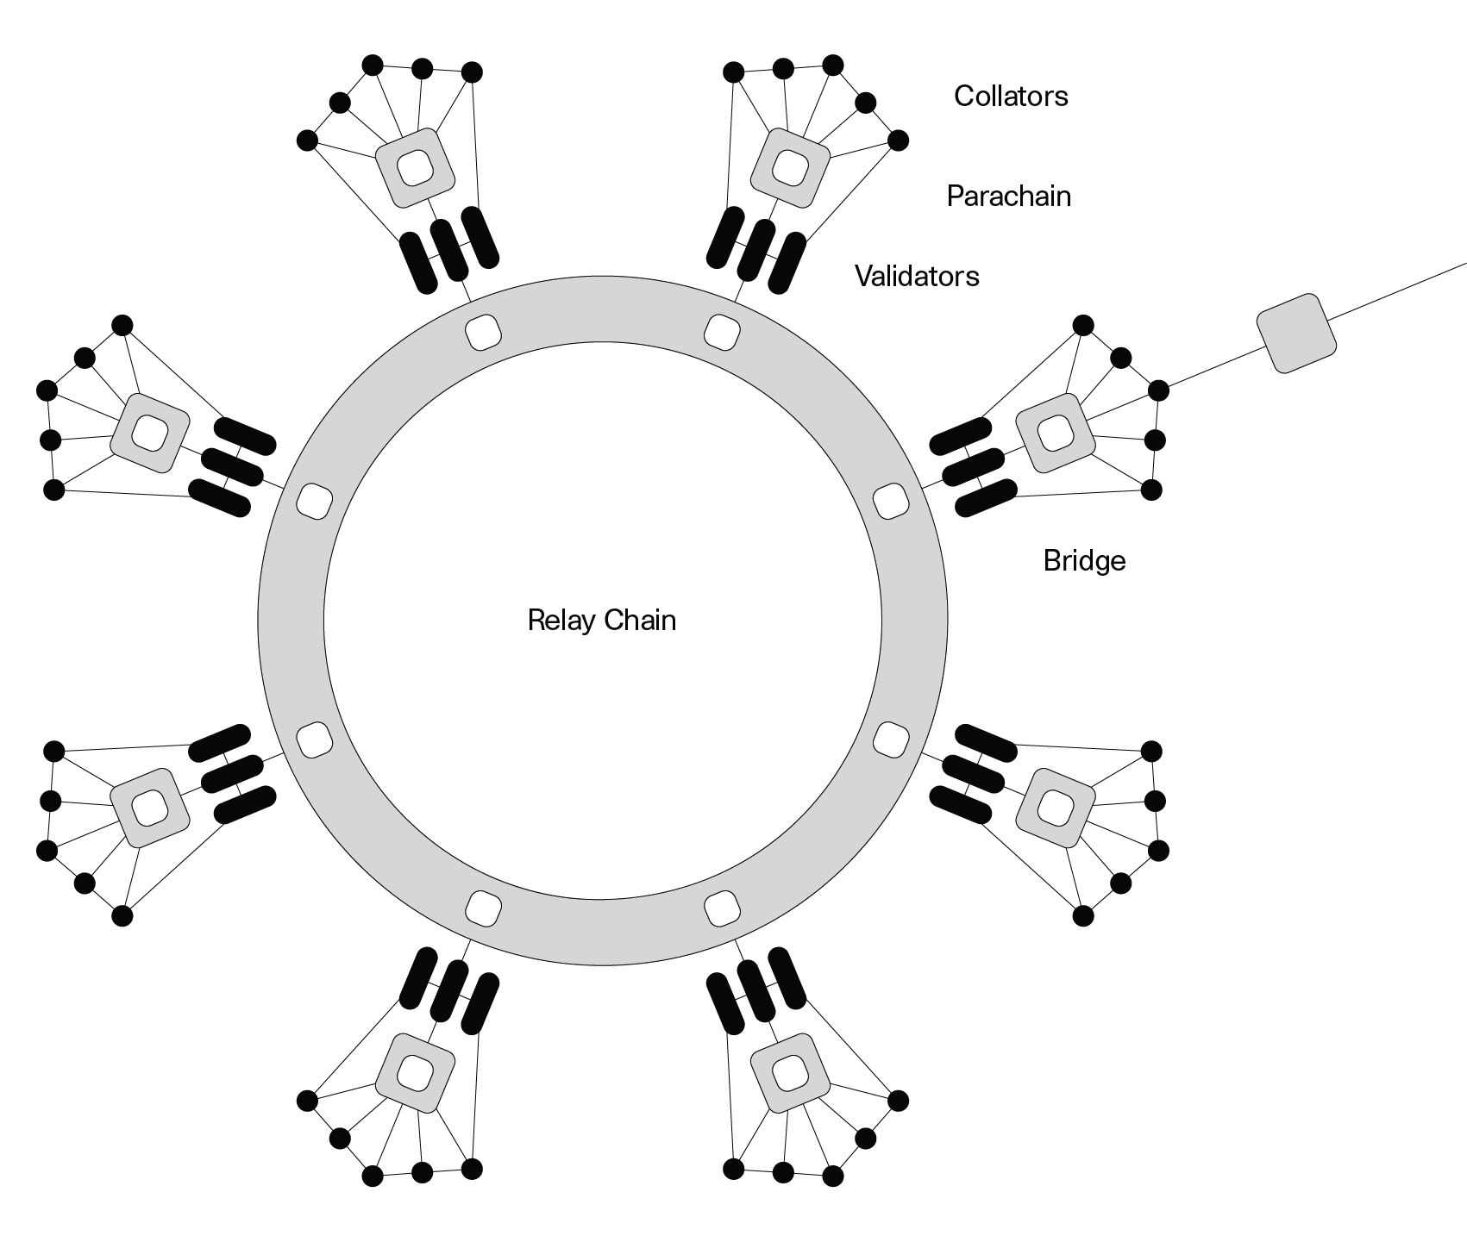
Execution Sharding
Execution Sharding is the process of distributing blockchain execution responsibilities across a validator set.
In Polkadot, all validators execute every relay chain block, but only a subset execute each parachain block.
This enables Polkadot to scale.
Notes:
Security in proof-of-stake networks depends on economics, so there can only exist a limited amount of security in the world because economic value is, by definition, limited. As the number of blockchains increases due to scaling issues on single chains, their economic value — and therefore their security — gets spread out over multiple chains, leaving each one weaker than before.
Polkadot introduces a shared security model so that chains can interact with others while knowing full well that their interlocutors have the same security guarantees as their own chain. Bridge-based solutions — where each chain handles its own security — force the receiver to trust the sender. Polkadot’s security model provides the necessary guarantees to make cross-chain messages meaningful without trusting the security of the sender.

Slide 24
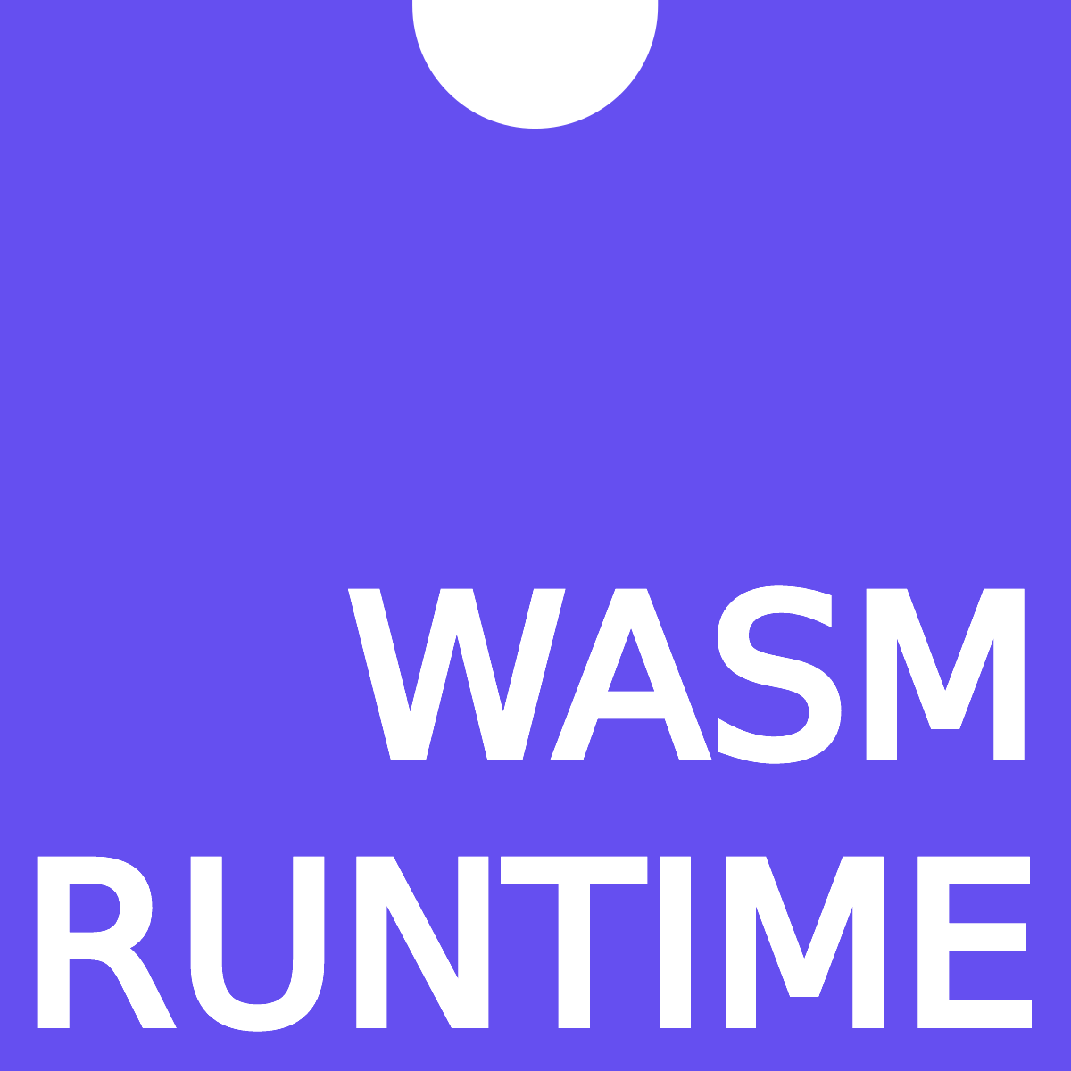
How to validate a block?
State Transition Function
Validates the Block
PoV
Block of Transactions
A
B
C
D
E
A’
B’
C’
D’
E’
Partial merkle trie with relevant data needed for transactions. (Proof of Validity)
New State Root
Generated

Slide 25
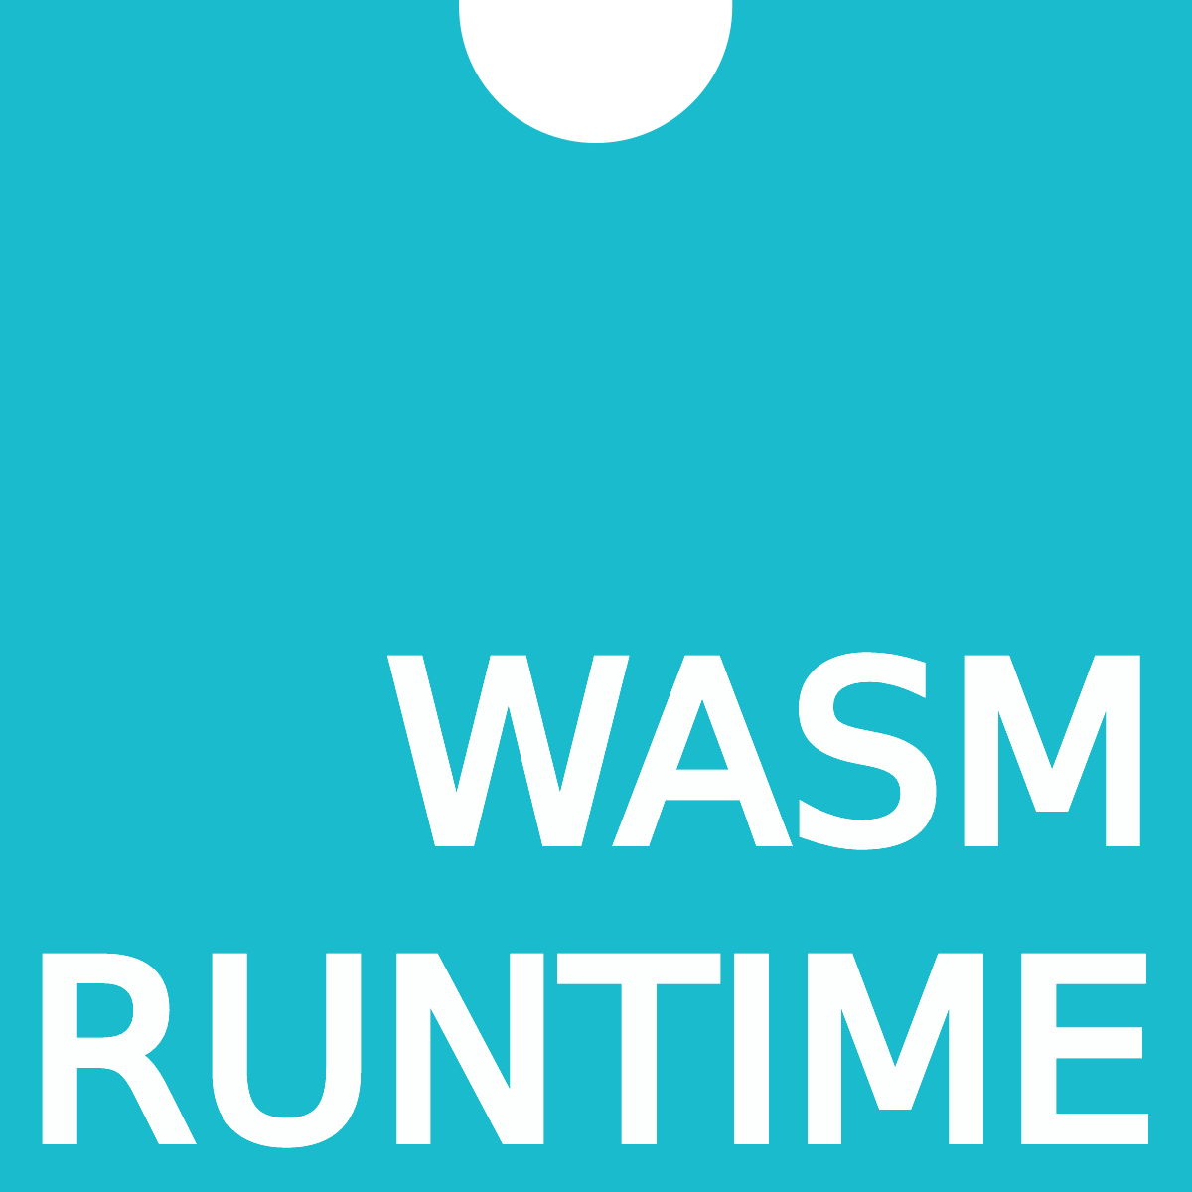
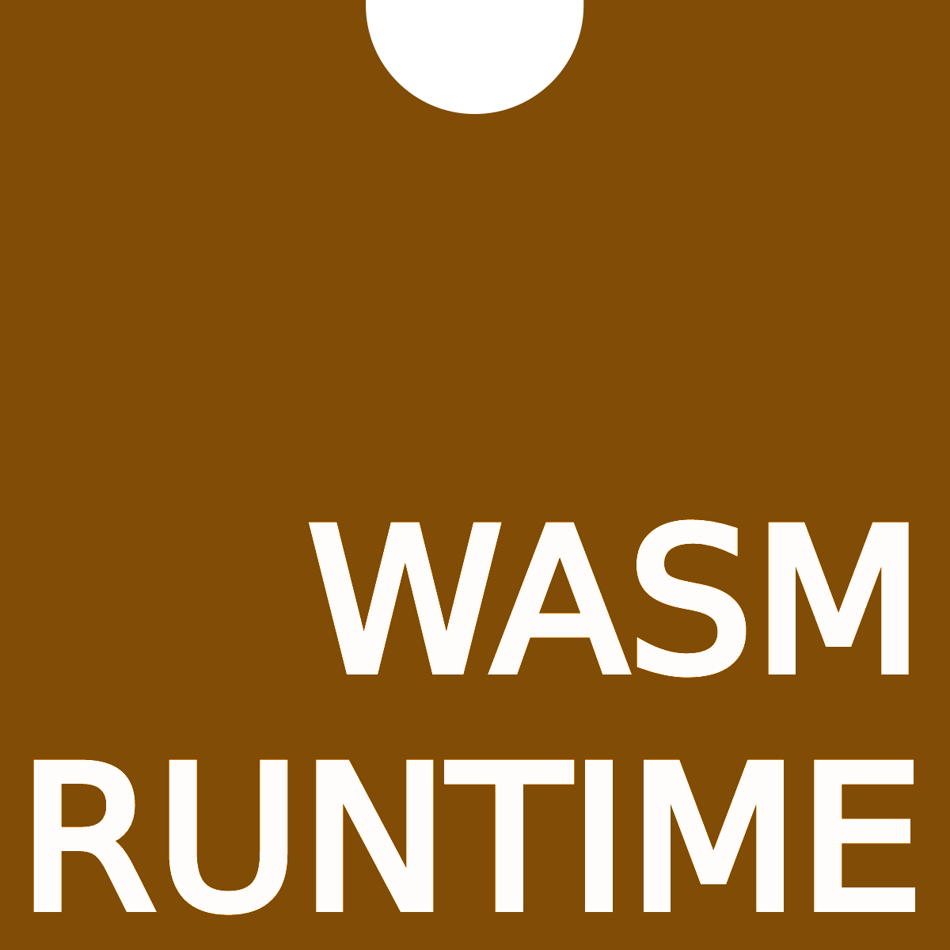
Parachains submit new blocks with a proof-of-validity to the network.
PoV
Block of Txs
A
C
E
Block of Txs
Block of Txs
PoV
PoV
A
C
E
A
C
E
ROOT
ROOT
ROOT
Wasm Runtime and latest state root for Parachains already stored on the relay chain.

Slide 26
Block of Txs
Block of Txs
Block of Txs
PoV
PoV
PoV
Parachains Protocol has new blocks that it needs to validate and include.
A
C
E
A
C
E
A
C
E
Polkadot Validators

Slide 27
Block of Txs
Block of Txs
Block of Txs
PoV
PoV
PoV
A random subset of validators are assigned to execute the parachain blocks.
A
C
E
A
C
E
A
C
E
The new state root is then committed to the relay chain so the process can repeat.

Slide 28
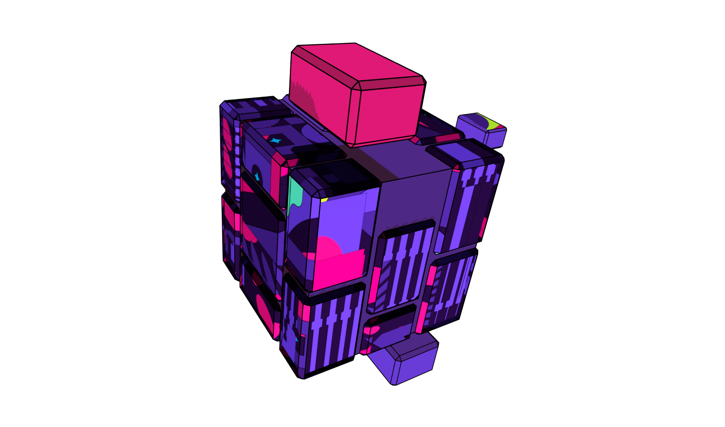
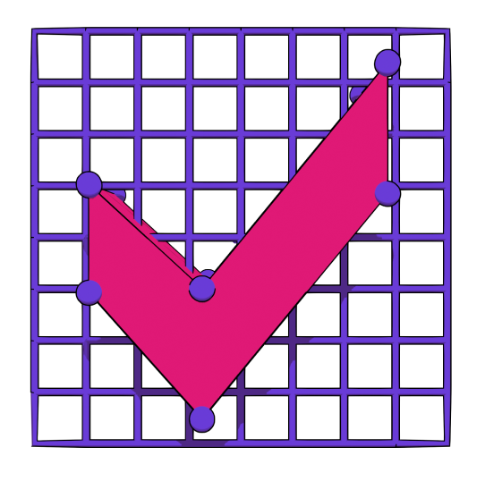
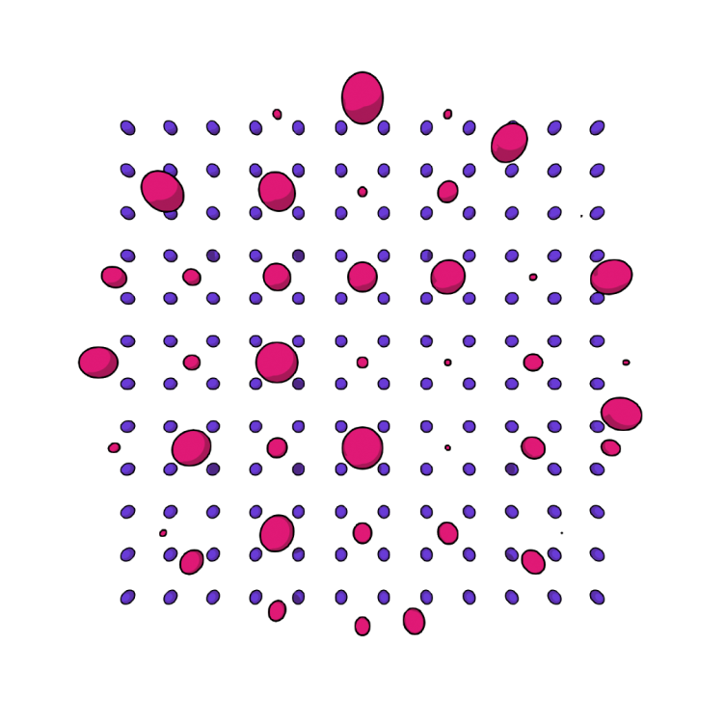
How do we stop things from going wrong?
Data Availability
Approval Checking
Disputes Handling
Polkadot uses erasure encoding across the validators assigned to a parachain to make sure the data needed to validate a block stays available.
Every validator node is running an approval checking process for every parachain block in every relay chain block.
When someone disputes the validity of a parablock, all validators must then check the block and cast a vote. The validators on the losing side of the dispute are slashed.

Slide 29
Parachain Blocks Get Finalized
n+1
Relay chain block producers commit the new state root to the relay chain once the Parachains Protocol has been completed.
Thus, when a relay chain block is finalized all included parachain blocks will also be finalized!
The Parachain state committed on Polkadot is the canonical chain.
n
Parachain Blocks Finalizing with the Relay Chain
n-1
n-2
n-3

Slide 30
Trust-Free Interactions
n+1
This also means that finalization on Polkadot implies finalization of all interactions between all parachains at the same height.
So, shared security not only secures the individual chains, but the interactions between chains too.
n
Parachain Blocks and Interactions Finalizing with the Relay Chain
n-1
n-2
n-3

Slide 31
Wasm
Parachains Protocol
Relay Chain

Slide 32
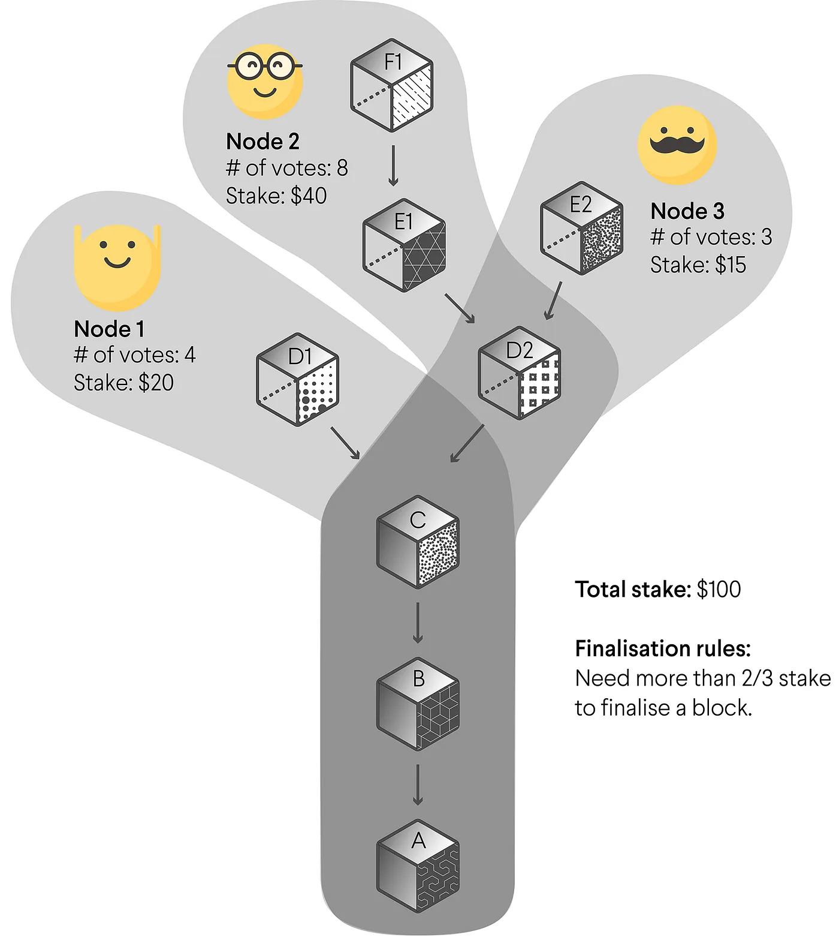
BABE
Block Production
GRANDPA
Finality Gadget
BABE is forkful, with probabilistic finality
Hybrid Consensus

Slide 33
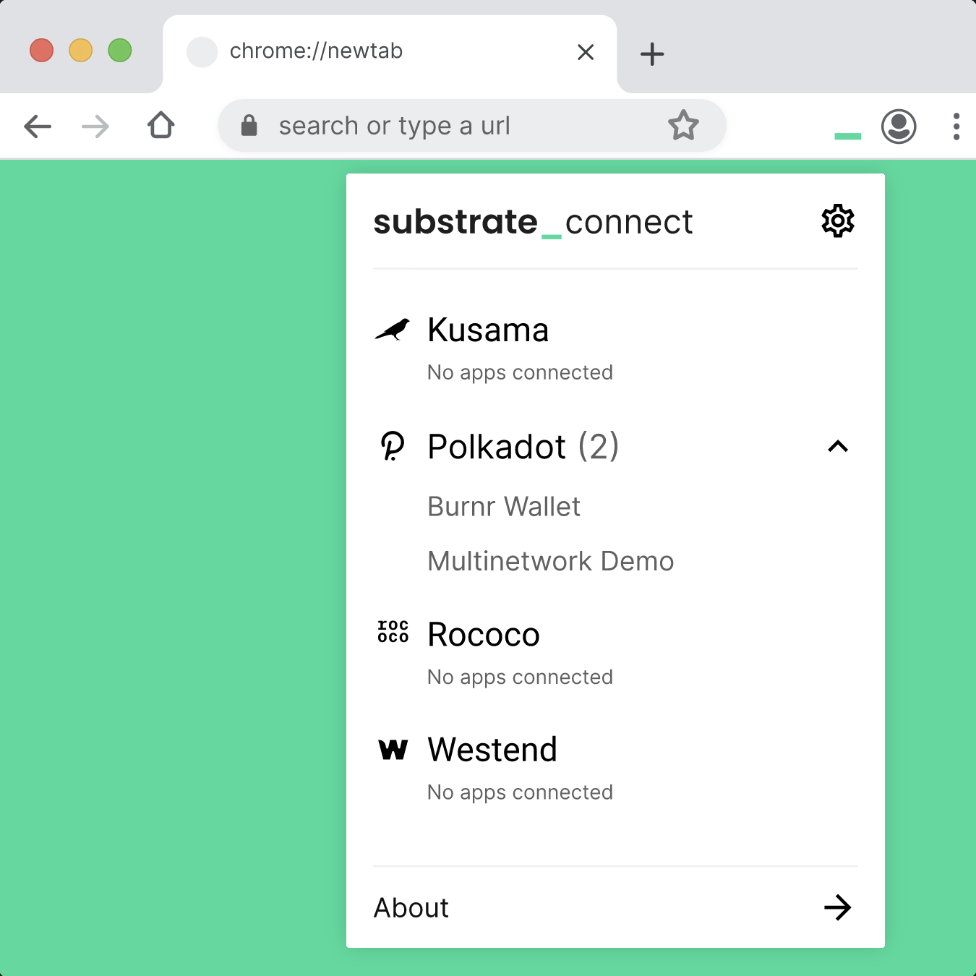
Light Client First Mentality
Polkadot has a strong belief that light clients are a necessary component for a Web3 future. It has been uncompromising in enabling first class light client support as a primary part of its development process:
In-Browser Wasm Client (Substrate Connect)
Wasm state transition function too!
Consensus data integrated into block headers
Merkle Tries and other LC compatible data structures
Maximizing statically known metadata to offset reliance on full nodes.

Slide 34
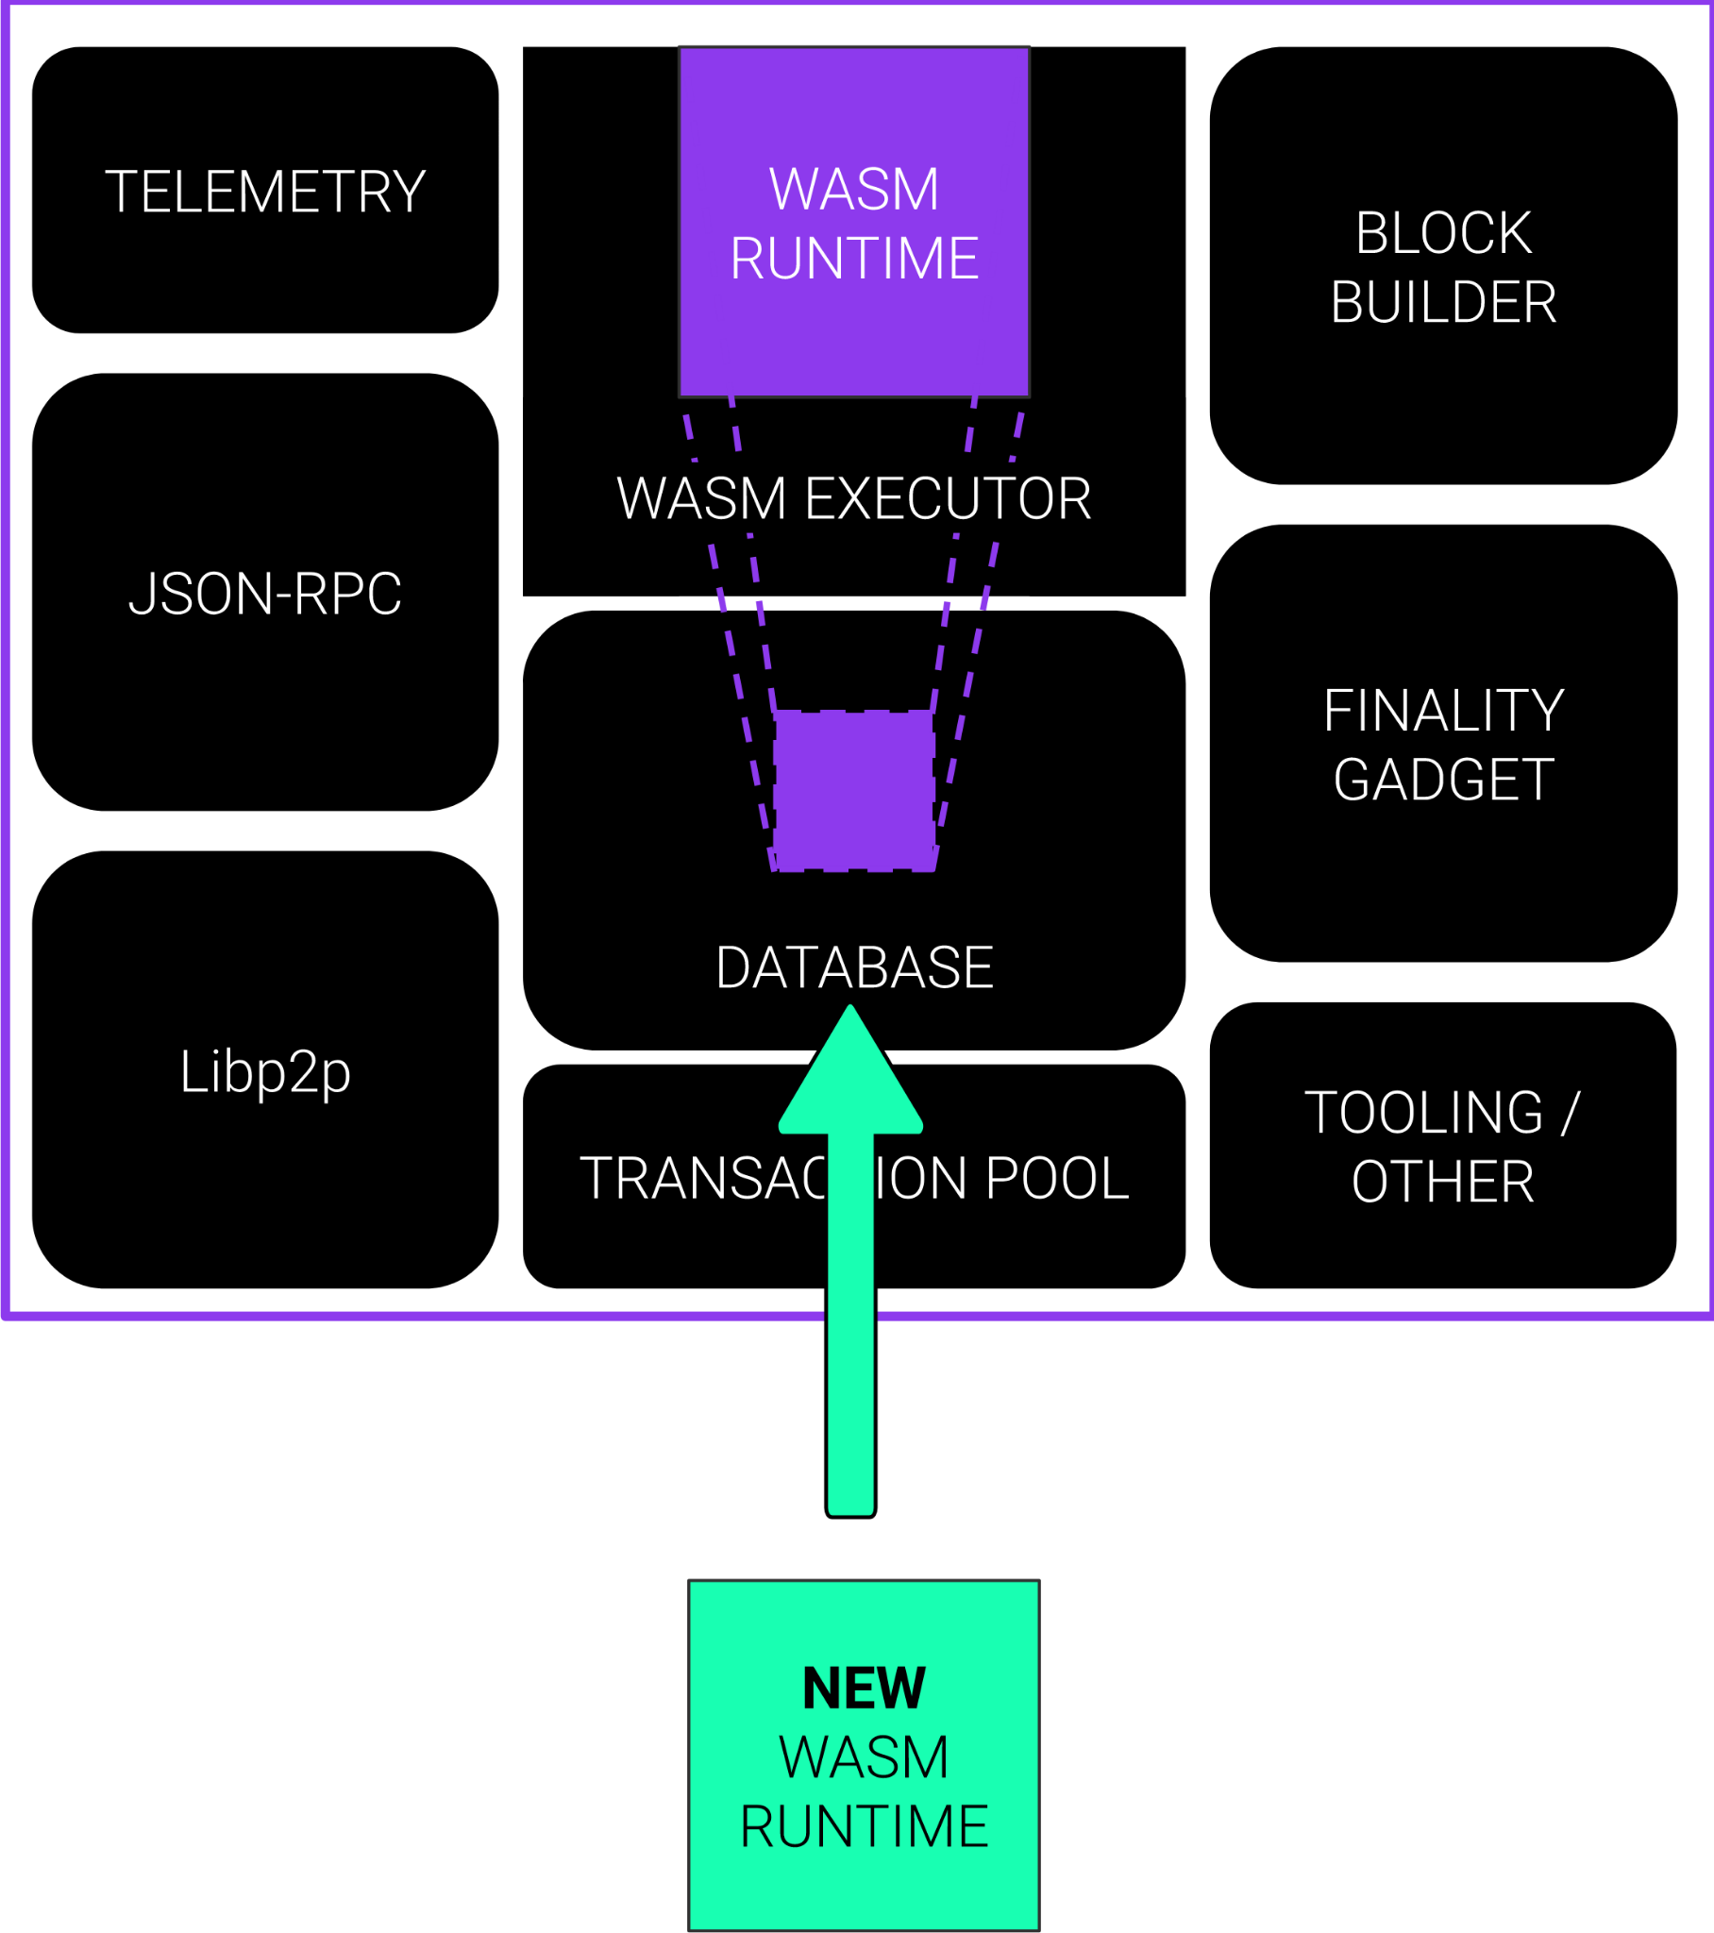
On-Chain Runtime
& Forkless Upgrades
The Polkadot protocol specification defines a clear separation between the blockchain client and runtime (state transition function).
This is primarily useful to implement the Parachains protocol, but also allows for chains to “forklessly” upgrade their chain.
This gives the Polkadot Relay Chain and all connected parachains an evolutionary advantage over others in the blockchain space.

Slide 35

On-Chain Governance
Polkadot and its parachains need to change over time to stay relevant, and the network was designed from the beginning to have a transparent and sophisticated process to not only approve or reject changes but also enact them automatically.
Governance decisions can literally change the underlying code of the chain (since it is on-chain).
50% of the total stake in the system should be able to control the future of the system.
Users have the option to lock their tokens to increase the “conviction” of their vote.

Slide 36

On-Chain Treasury
Polkadot has designed at its core a self-funded treasury pool to incentivize the development and evolution of the protocol.
It is entirely controlled on-chain by the governance system of Polkadot, which means that it is immune to the regulations which would normally be imposed to centralized entities.

Slide 37
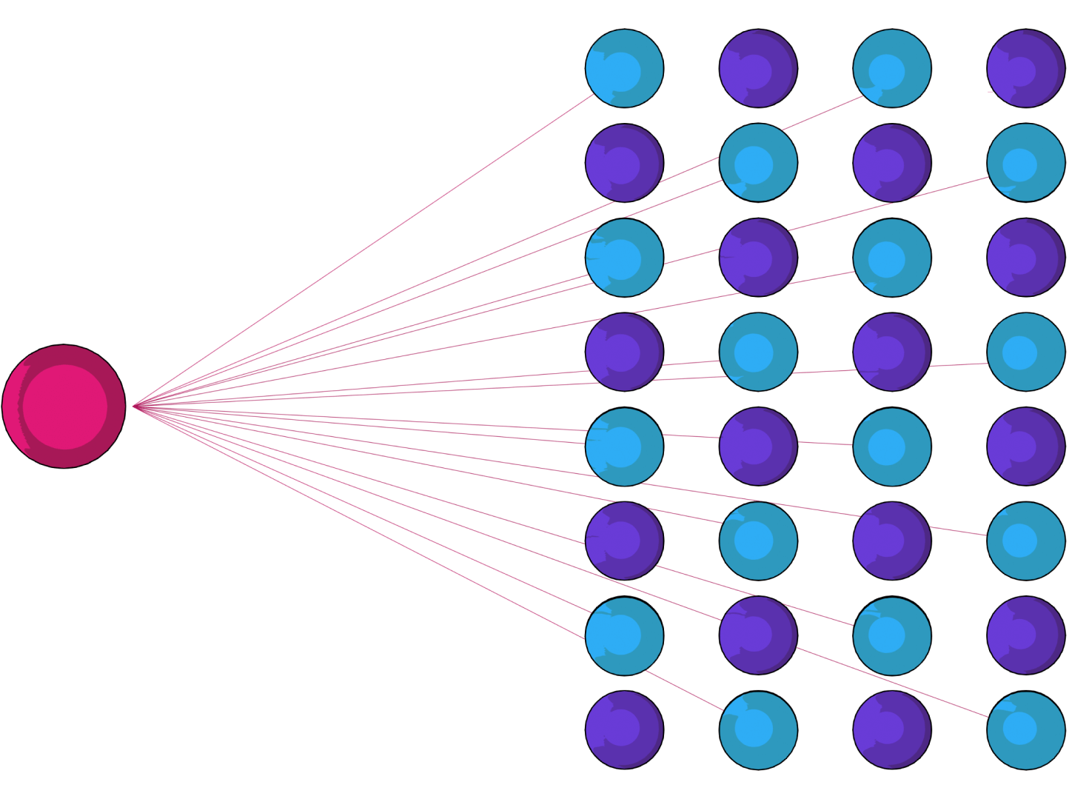
Nominated Proof-of-Stake
One of Polkadot’s primary functions is to provide security not only to itself, but also to the connected Parachains. The staking system is a critical focus of the network, and we have one of the most advance staking systems to date.
NPoS over DPoS to better allocate stake.
At the cost of complexity and scaling.
Economic incentives to distribute funds evenly across validators.
Super-linear slashing system to discourage validator centralization.
Actual value being generated by staking, justifying rewards.

Slide 38
The Ecosystem

Slide 39
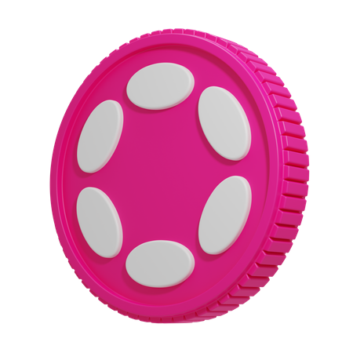
The DOT Token
DOT is a utility token that serves 3 main purposes beyond transferability:
Purchasing Blockspace
Securing the Network (Staking)
On-Chain Governance
Flexible and secure blockspace is valuable, thus the DOT token has intrinsic value and utility.

Slide 40
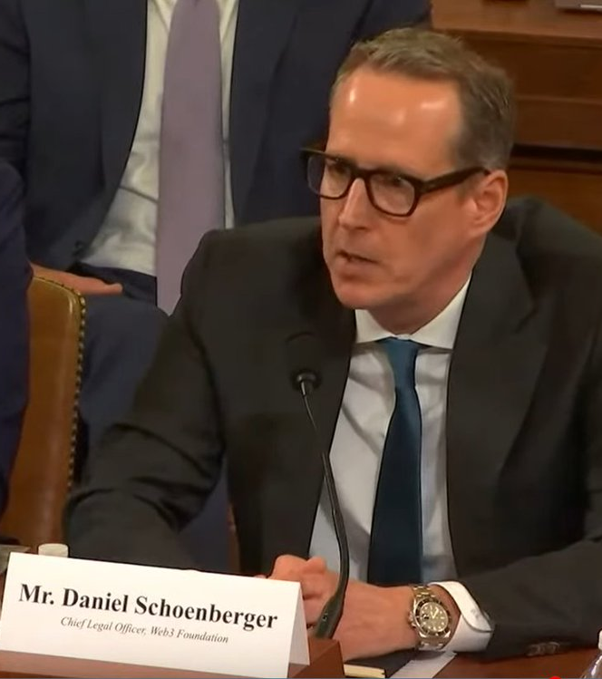

Regulatory Clarity
The Web3 Foundation has worked with the SEC for nearly 4 years to navigate the DOT token through US financial regulation.
As a result, DOT token is considered software, not a security.
Chief Legal Officer of the Web3 Foundation recently represented Polkadot in front of the Financial Services-Agriculture Subcommittee.

Slide 41
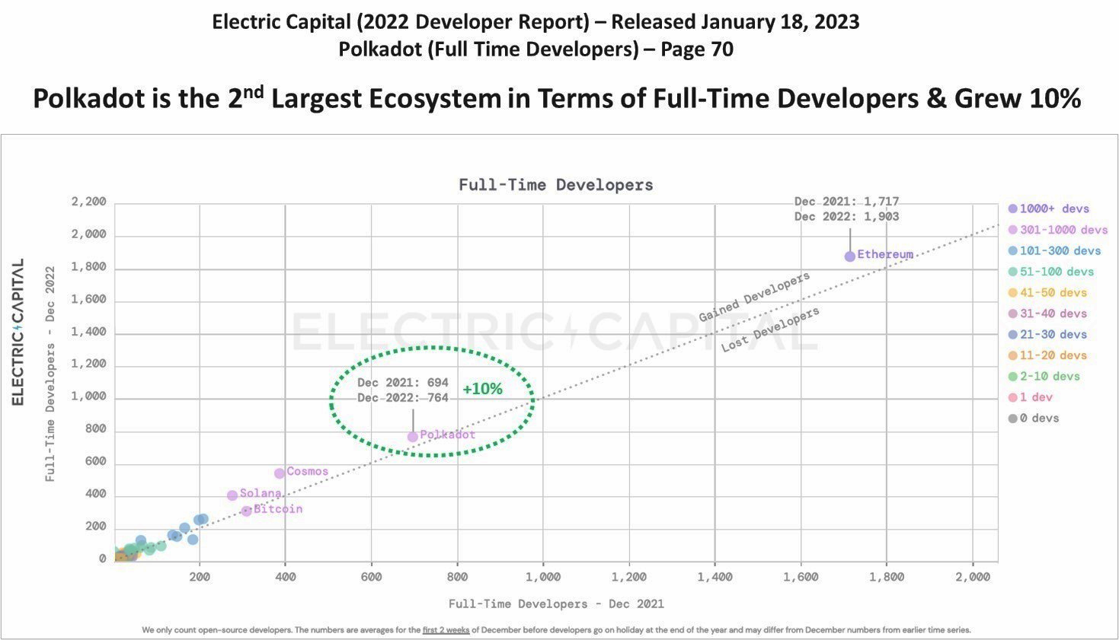

Slide 42
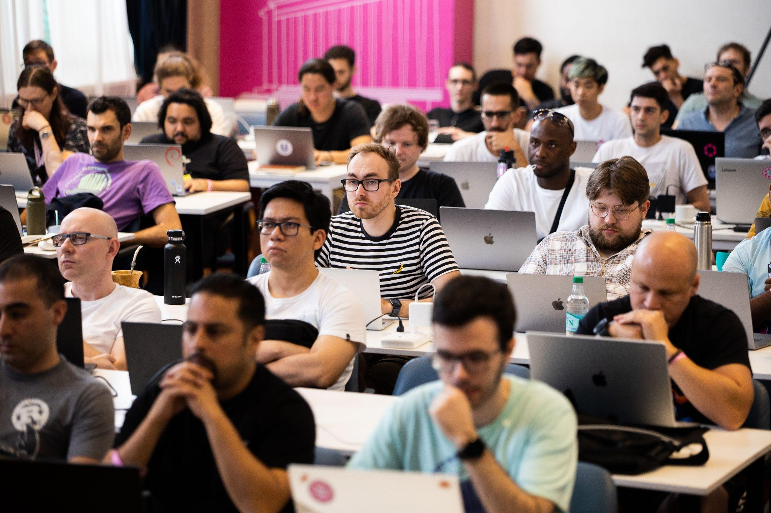
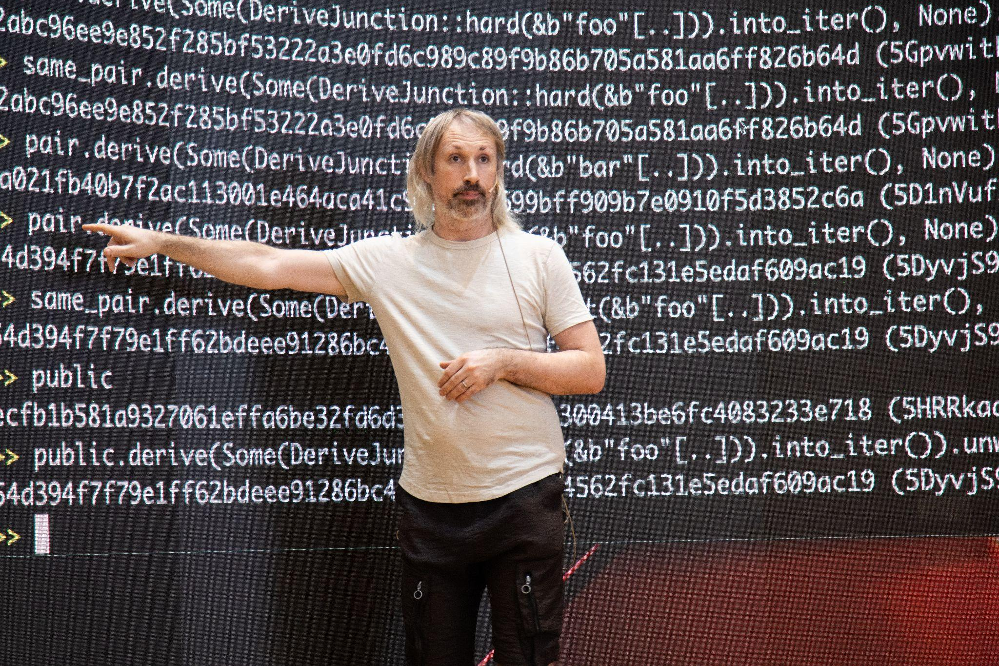
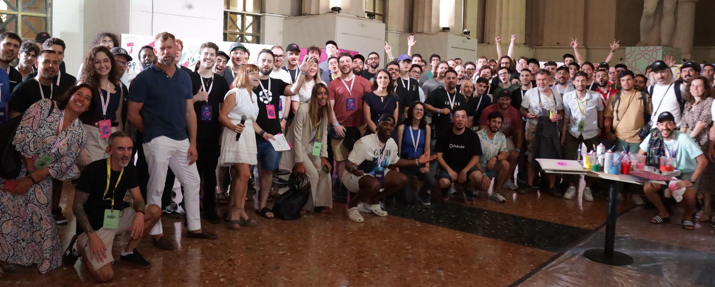
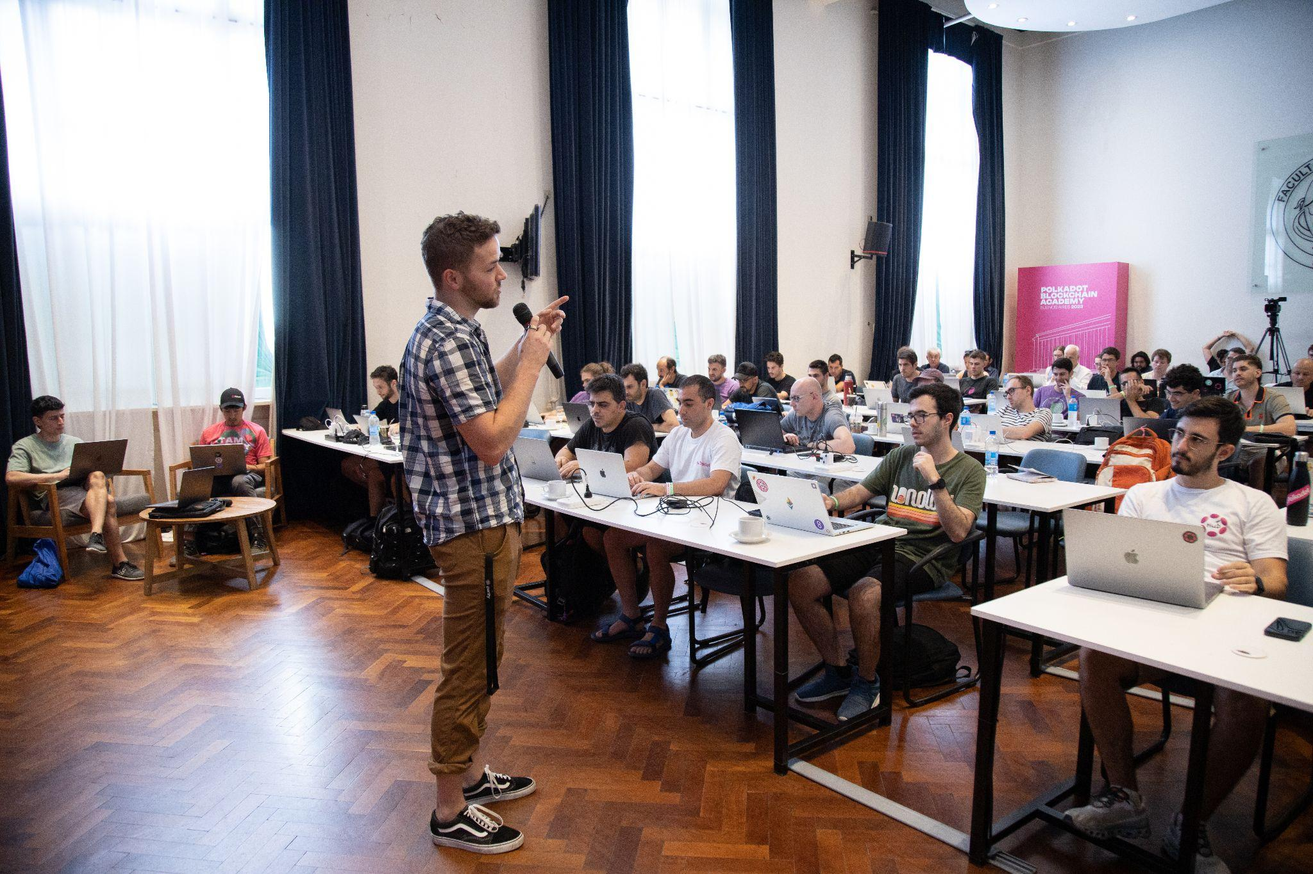
and growing even faster…
3 Global Cohorts
5 Weeks, In-Person
8 Modules
~800 Applicants*
~70 Students*
* per cohort
~40 Graduates*
https://polkadot.network/academy/
~20 Hires*

Slide 43
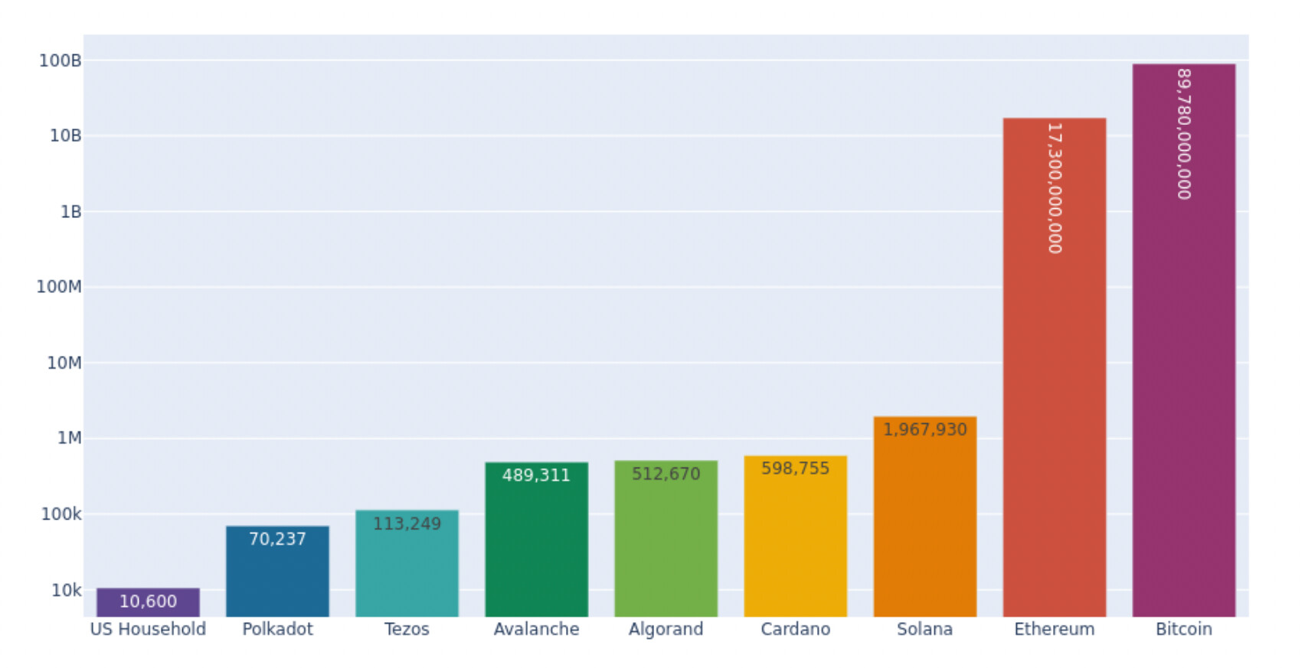
Polkadot is the Greenest Blockchain
Figure 4: Yearly electricity consumption for Bitcoin, Ethereum, Proof of Stake networks Polkadot, Tezos, Avalanche, Algorand, Cardano and Solana, and an average US household in kWh. Logarithmic scale. (July 2022, Crypto Carbon Rating Institute)

Slide 44
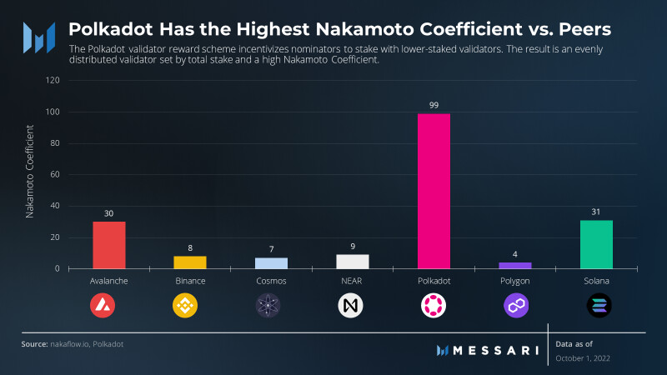

Slide 45
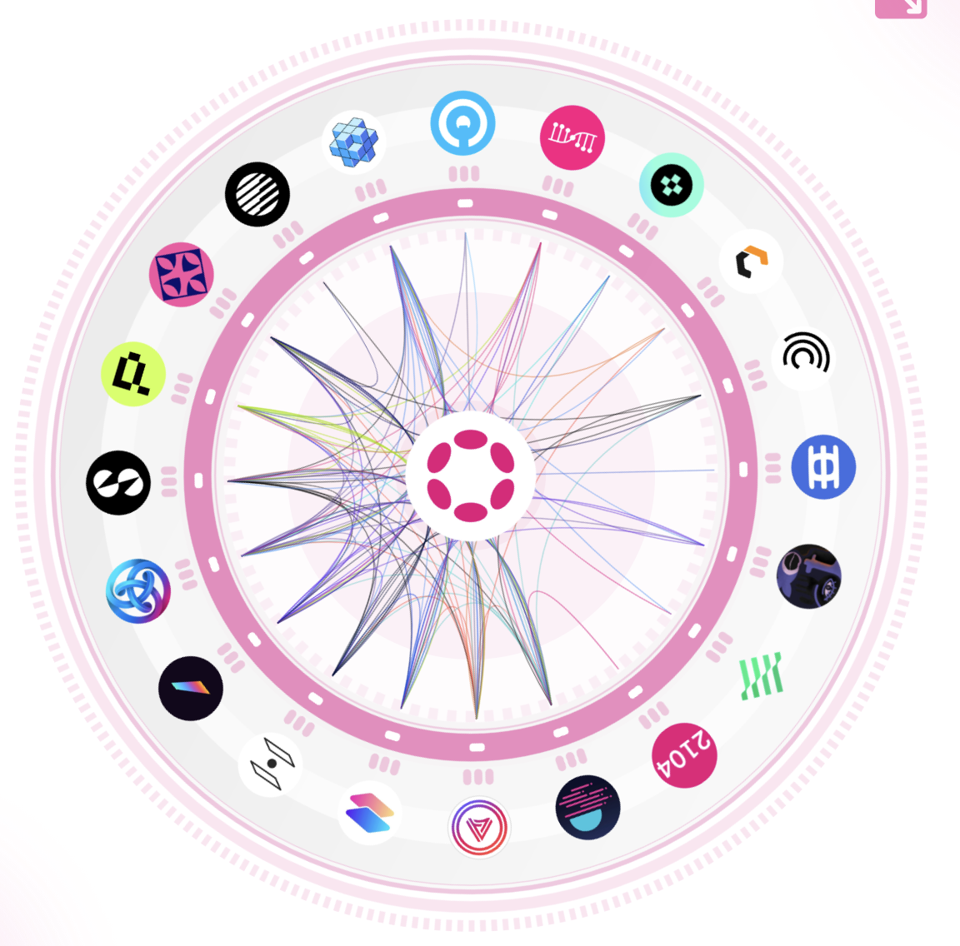
Beyond the Relay Chain
The Polkadot Network is often misrepresented by just the Relay Chain and the DOT token.
However, Polkadot is really the entire ecosystem of:
Parachains Built on Polkadot.
Applications Built on those Parachains.
Users who engage with and use those applications.

Slide 46

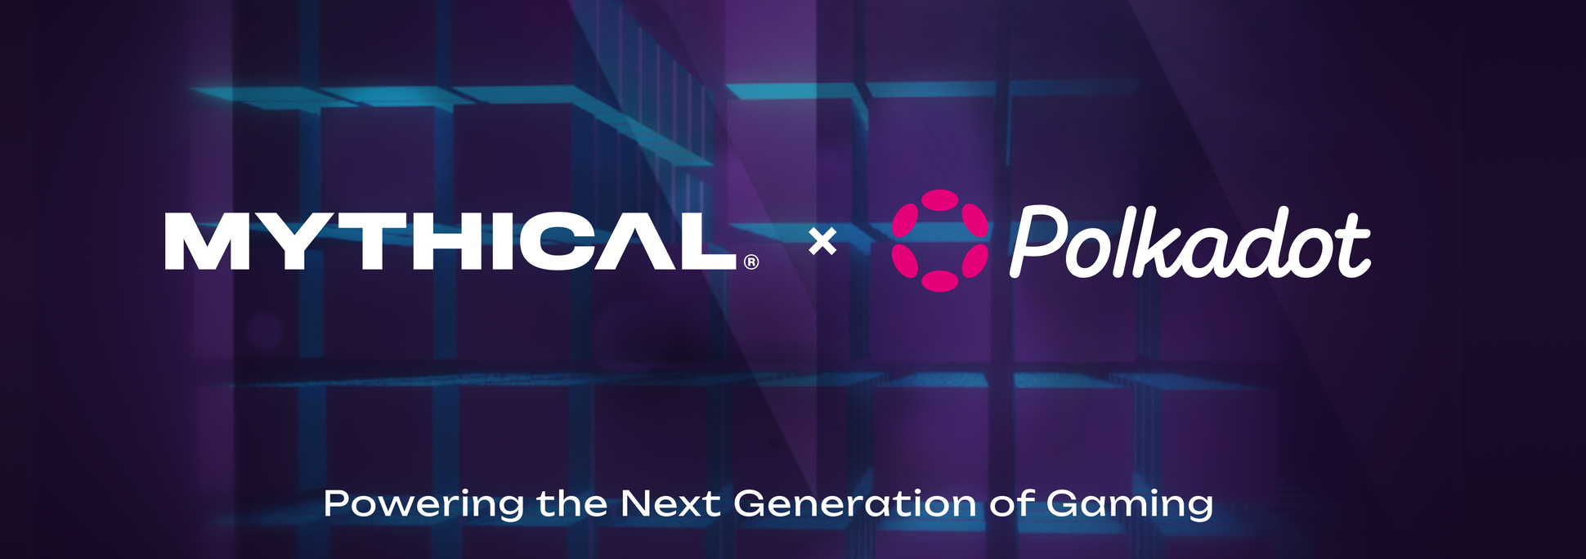
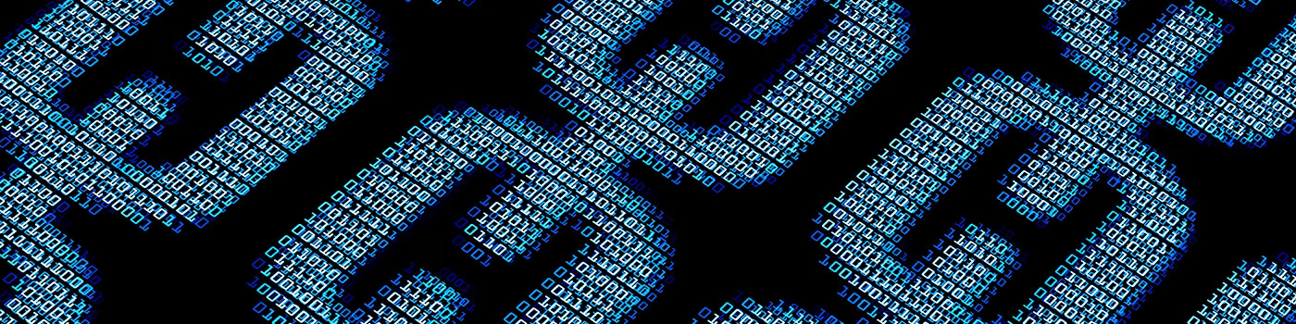



Headlines in 2023
Sony Teams Up With Astar Network for Web3 Incubation Program
Polkadot and Mythical Games: Powering the Next Generation of Gaming
Deloitte Integrates KILT Identity Blockchain, Creating New Markets with Reusable Digital Credentials
March 13
April 27
May 17
Feb 16
April 26
May 4
Beatport, Polkadot & Aventus Join Forces to Launch a Web3 Electronic Music Platform
MeWe social network with 20M users to integrate with Polkadot parachain
Uniswap will deploy on Polkadot parachain Moonbeam

Slide 47



Sony
…the largest technology company in Japan, is teamed up with the team behind Astar, a multi-contract parachain on Polkadot, to launch a Web3 incubation program.
Participants of the program will work with Sony, Astar, and global venture capital firms to create blockchain based applications which can solve various problems within Sony’s ecosystem.

Slide 48


Beatport
…the world's largest electronic music store for DJs, teamed up with Polkadot to launch Beatport.io, a digital collectible marketplace bringing electronic music culture to Web3.
Beatport.io will launch on Aventus, a Web3 solutions provider for enterprises and an active Polkadot parachain.

Slide 49

Mythical Games
…the number one gaming blockchain and top four blockchain of all by monthly digital asset sales, left Ethereum to launch their new Mythos ecosystem on Polkadot.
This enables Mythos gaming partners to build their own chains to create the biggest, most connected gaming ecosystem in Web3.

Slide 50


The official free-to-play, fantasy football game of the NFL.
Players can draft their own team of NFL players and compete against other players in head-to-head matchups
Players can earn rewards for winning matchups, including NFTs, in-game currency, and real-world prizes
Over 100,000 registered players.
Over $1 million in NFTs sold.
Over 100,000 unique NFTs in the game.

Slide 51

A free-to-play, open-world blockchain-based multiplayer game.
Players can collect, customize, and race their own Blankos, which are vinyl toys that come to life.
Players can also create their own levels and share them with the community.
Over 1 million registered players.
Over $10 million in NFTs sold.
Over 100,000 unique NFTs in the game.

Slide 52

MeWe
…is a privacy first social media company with over 20M users.
They partnered with Frequency, a parachain on Polkadot, to bring their network and users to the Decentralized Social Web.
The first initiative is to deliver a self-sovereign Social Identity that is fully owned by each user.

Slide 53

Deloitte
…the largest professional services network in the world, announced integration of KILT’s parachain for issuing reusable digital credentials to support KYC and KYB processes.
These credentials have multiple use cases including regulatory compliance for banking and DeFi, age verification for e-commerce, private logins and fundraising.

Slide 54


Uniswap
…the largest DEX by volume, is teaming up with Moonbeam to bring the decentralized exchange to the Polkadot ecosystem.
Moonbeam is an Ethereum compatible parachain on Polkadot.
Uniswap is doing over $480 million in trading per day.

Slide 55











Slide 56


























































































Slide 57
Questions?
Thank you
Follow me @shawntabrizi anywhere there is social media.

